Slide 1
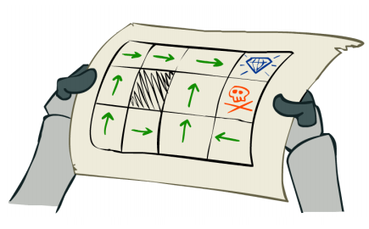
L7.1 MDP Planning
Zonghua Gu 2021
Acknowledgement: slides based on https://www.coursera.org/specializations/reinforcement-learning
And textbook by Sutton and Barto http://incompleteideas.net/book/the-book-2nd.html

Slide 2
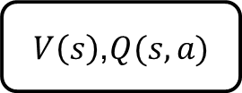
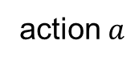
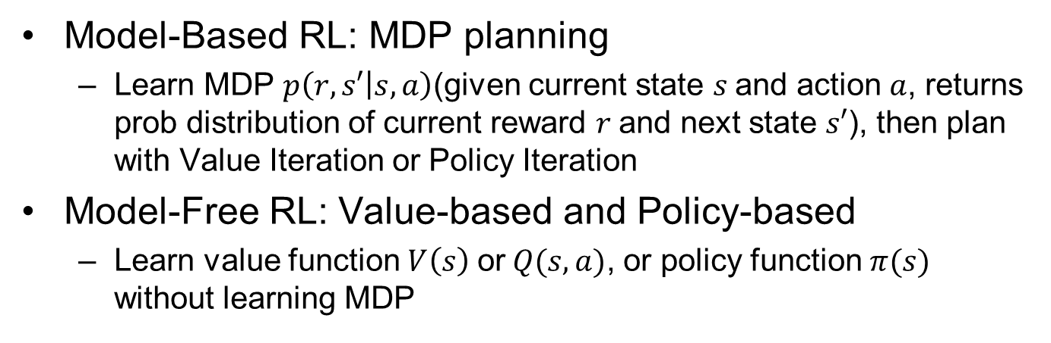
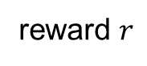
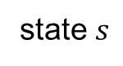

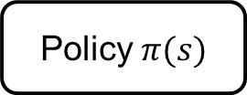
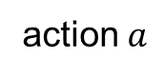
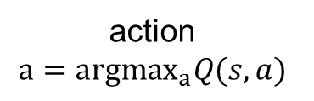
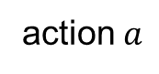
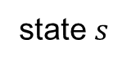
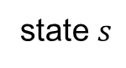
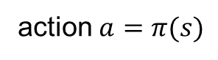
Model-Based vs. Model-Free
Model-Based RL: MDP planning
Learn MDP $p\left(r,s′ | s,a\right)$(given current state $s$and action $a$, returns prob distribution of current reward $r$and next state $s′$), then plan with Value Iteration or Policy Iteration
Model-Free RL: Value-based and Policy-based
Learn value function $V\left(s\right)$ or$Q(s,a)$, or policy function $π(s)$ without learning MDP
state $s$
action $a$
state $s$
action $a$
state $s$
action $a$
MDP
$V\left(s\right)$,$Q(s,a)$
Policy $π(s)$
next
state $s′$
reward $r$
action
$$a={argmax}_{a}Q(s,a)$$
action $a=π(s)$
MDP Planning | Value-based RL | Policy-based RL
Notes:
Model-based
Learn MDP model $p\left(r,s′ | s,a\right)$, then solve for the optimal policy with PI or VI.
Model-free
Learn the optimal policy without learning MDP.
MPC is model-based; PID can be model-based or model-free $\left[s_{t+1},r_{t}\right]∼P(⋅|s_{t},a_{t};θ)$ $a_{t}=π(s_{t},θ)$ Estimate value $J(θ)$ and optimize it, without knowledge of model $P$Q-Learning/DQN, Policy Gradient, Imitation Learning… $θ$ denotes model params, e.g., edge weights in a DNN.

Slide 3
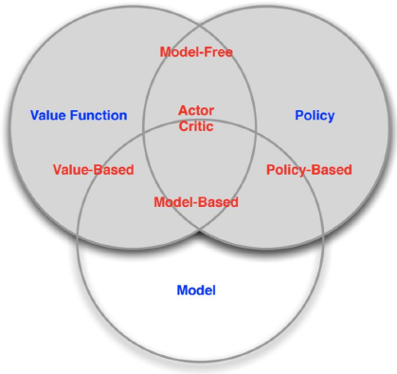
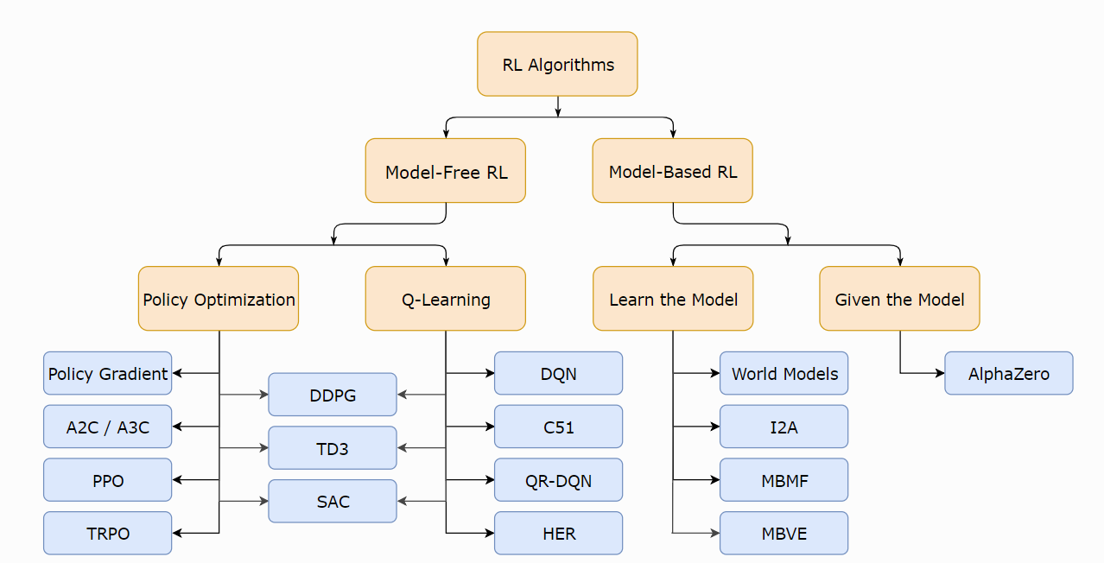
Overview of RL Algorithms

Slide 4
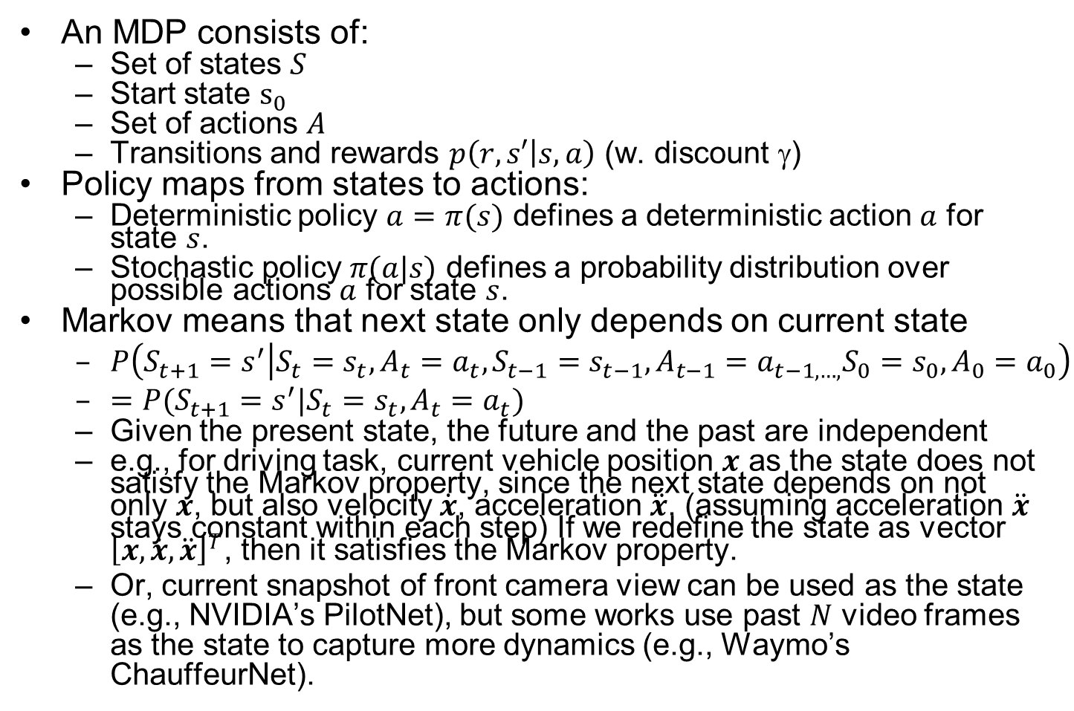
Markov Decision Process (MDP)
An MDP consists of:
Set of states $S$
Start state $s_{0}$
Set of actions $A$
Transitions and rewards $p\left(r,s′ | s,a\right)$ (w. discount $$)
Policy maps from states to actions:
Deterministic policy $a=π(s)$ defines a deterministic action $a$ for state $s$.
Stochastic policy $π(a|s)$ defines a probability distribution over possible actions $a$ for state $s$.
Markov means that next state only depends on current state
$P\left(S_{t+1}=s^{′} | S_{t}=s_{t},A_{t}=a_{t},S_{t−1}=s_{t−1},A_{t−1}=a_{t−1,…,}S_{0}=s_{0},A_{0}=a_{0}\right)$
$=P(S_{t+1}=s^{′}|S_{t}=s_{t},A_{t}=a_{t})$
Given the present state, the future and the past are independent
e.g., for driving task, current vehicle position $x$ as the state does not satisfy the Markov property, since the next state depends on not only $x$, but also velocity $\dot{x}$, acceleration $\ddot{x}$. (assuming acceleration $\ddot{x}$ stays constant within each step) If we redefine the state as vector ${\left[x,\dot{x}, \ddot{x}\right]}^{T}$, then it satisfies the Markov property.
Or, current snapshot of front camera view can be used as the state (e.g., NVIDIA’s PilotNet), but some works use past $N$ video frames as the state to capture more dynamics (e.g., Waymo’s ChauffeurNet).
Notes:
Add utility slide, (like policy) Utility (Cumulative Reward) measured by Value function $V(s)$: sum of cumulative (discounted) rewards (utility) starting from state $s$ TODO 2 versions, optimal or policy
Q Value function $Q(s,a)$: sum of cumulative (discounted) rewards (utility) starting from state $s$ and taking action $a$.
v

Slide 5
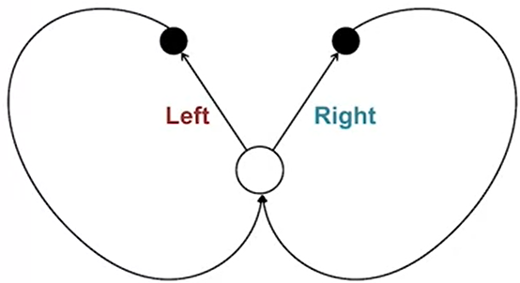
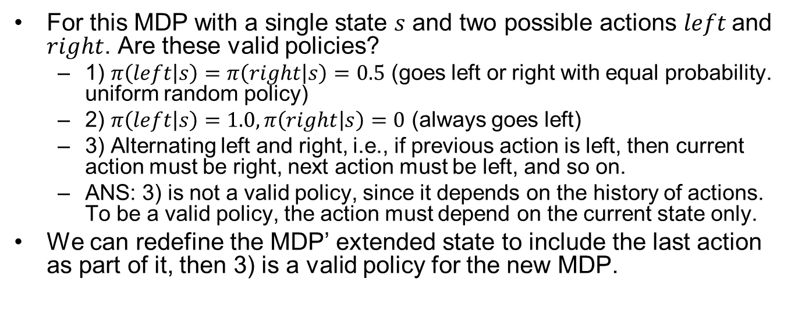
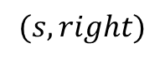
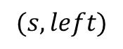
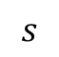
MDP Quiz
For this MDP with a single state $s$ and two possible actions $left$ and $right$. Are these valid policies?
1) $π\left(left | s\right)=π\left(right | s\right)=0.5$ (goes left or right with equal probability. uniform random policy)
2) $π\left(left | s\right)=1.0,π\left(right | s\right)=0$ (always goes left)
3) Alternating left and right, i.e., if previous action is left, then current action must be right, next action must be left, and so on.
ANS: 3) is not a valid policy, since it depends on the history of actions. To be a valid policy, the action must depend on the current state only.
We can redefine the MDP’ extended state to include the last action as part of it, then 3) is a valid policy for the new MDP.
$$(s, left)$$
$$(s, right)$$
$$s$$

Slide 6
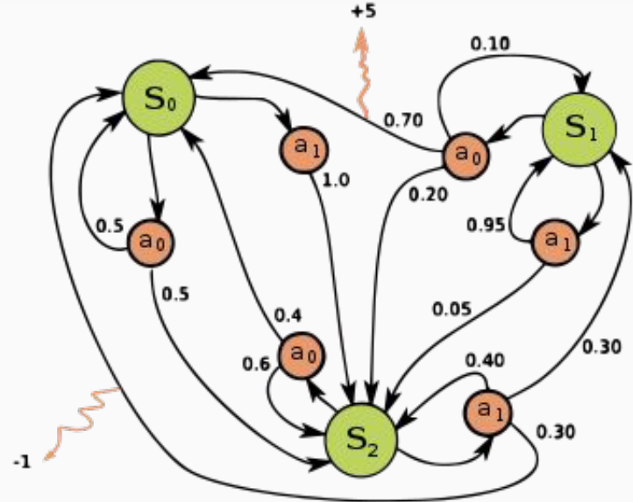
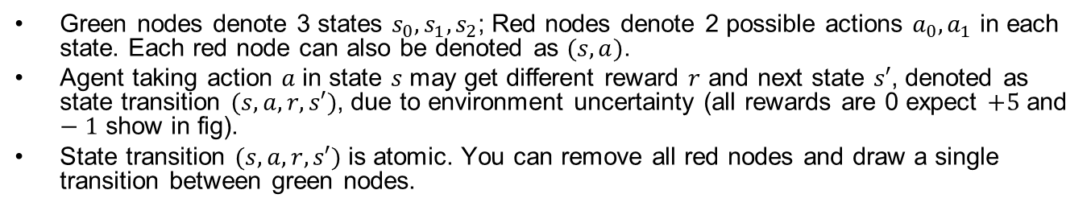
An Example MDP
Green nodes denote 3 states $s_{0},s_{1},s_{2}$; Red nodes denote 2 possible actions ${a_{0},a}_{1}$ in each state. Each red node can also be denoted as $(s,a)$.
Agent taking action $a$ in state $s$ may get different reward $r$ and next state $s′$, denoted as state transition $(s,a,r,s′)$, due to environment uncertainty (all rewards are 0 expect $+5$ and $−1$ show in fig).
State transition $(s,a,r,s′)$ is atomic. You can remove all red nodes and draw a single transition between green nodes.

Slide 7
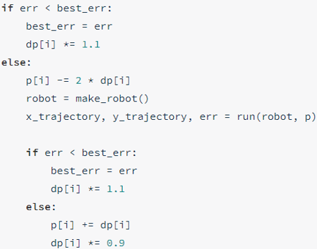
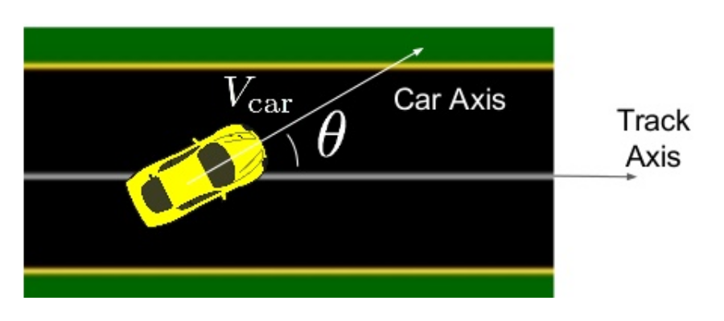
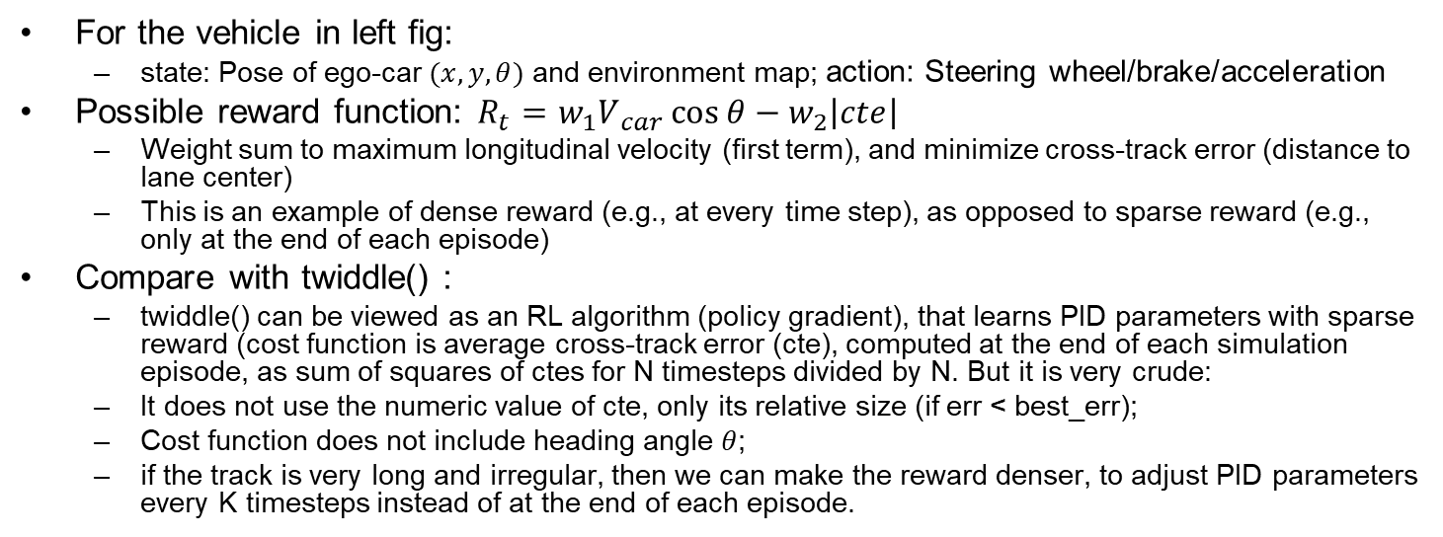
RL Reward Function
For the vehicle in left fig:
state: Pose of ego-car $(x,y,θ)$ and environment map; action: Steering wheel/brake/acceleration
Possible reward function: $R_{t}​=w_{1}V​_{car}\cos{θ}−​w_{2}\left|cte\right|​$
Weight sum to maximum longitudinal velocity (first term), and minimize cross-track error (distance to lane center)
This is an example of dense reward (e.g., at every time step), as opposed to sparse reward (e.g., only at the end of each episode)
Compare with twiddle() :
twiddle() can be viewed as an RL algorithm (policy gradient), that learns PID parameters with sparse reward (cost function is average cross-track error (cte), computed at the end of each simulation episode, as sum of squares of ctes for N timesteps divided by N. But it is very crude:
It does not use the numeric value of cte, only its relative size (if err < best_err);
Cost function does not include heading angle $θ$;
if the track is very long and irregular, then we can make the reward denser, to adjust PID parameters every K timesteps instead of at the end of each episode.
twiddle()
Ben Lau, Quantitative Researcher, Hobbyist, at MLconf NYC 2017
Notes:
PID controller is used to track a fixed circular path
Intuitive reward function: $R_{t}=V_{car}\cos{θ}$
maximum longitudinal velocity
Sometimes need to do “reward function hacking” to find one that works well, e.g., $R_{t}​=V​_{car}\cos{θ}−V_{car}​​​sin⁡θ−V​_{car}​\left|cte\right|​$
$$V_{car}​​​sin⁡θ$$

Slide 8
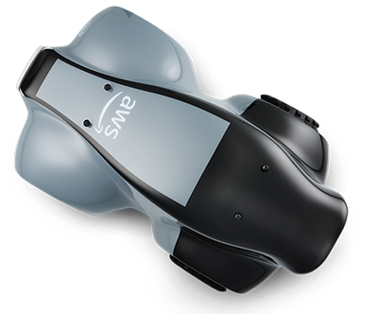
Amazon DeepRacer
Amazon Web Services (AWS) launched DeepRacer in 2018 for training AD algorithms with RL
https://aws.amazon.com/deepracer/
You can train RL algorithm in the simulator on AWS cloud, but it costs money after some free time.
They hold competitions, both online and in real-world. 1/10th scale race car costs USD $349.

Slide 9
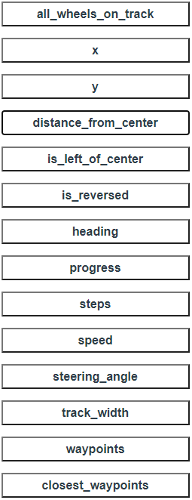
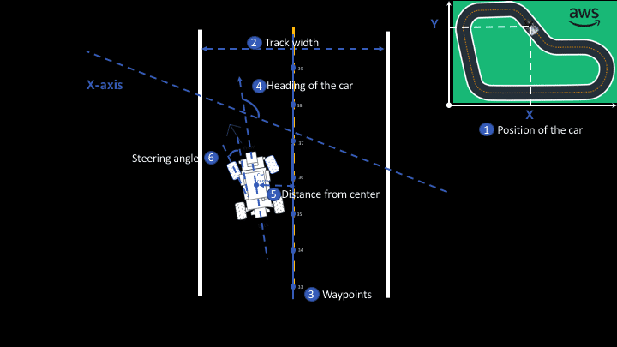
Params for Writing Reward Function
Notes:
Writing a Reward Function

Slide 10
Example Reward Function
def reward_function(params):
'''Example of penalize steering, which helps mitigate zig-zag behaviors'''
# Read input parameters
distance_from_center = params['distance_from_center']
track_width = params['track_width']
steering = abs(params['steering_angle']) # Only need the absolute steering angle
# Calculate 3 markers that are at varying distances away from the center line
marker_1 = 0.1 * track_width
marker_2 = 0.25 * track_width
marker_3 = 0.5 * track_width
# Give higher reward if the agent is closer to center line and vice versa
if distance_from_center <= marker_1:
reward = 1
elif distance_from_center <= marker_2:
reward = 0.5
elif distance_from_center <= marker_3:
reward = 0.1
else:
reward = 1e-3 # likely crashed/ close to off track
# Steering penalty threshold, change the number based on your action space setting
ABS_STEERING_THRESHOLD = 15
# Penalize reward if the agent is steering too much
if steering > ABS_STEERING_THRESHOLD:
reward *= 0.8
return float(reward)
A more realistic and complex reward function: https://www.middleware-solutions.fr/2019/08/14/an-introduction-to-aws-deepracer

Slide 11



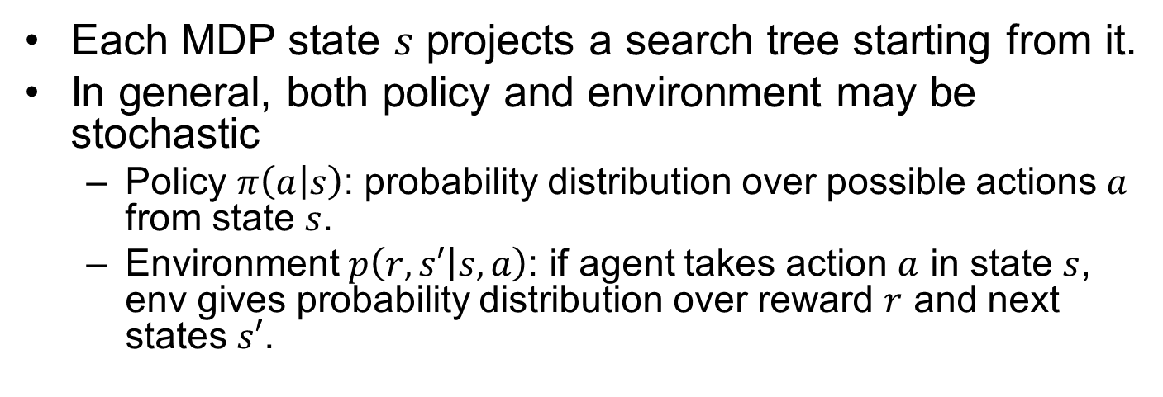
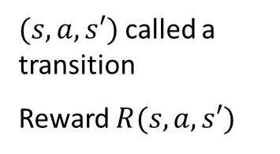
MDP Search Tree
Each MDP state $s$ projects a search tree starting from it.
In general, both policy and environment may be stochastic
Policy $π\left(a | s\right)$: probability distribution over possible actions $a$ from state $s$.
Environment $p\left(r,s′ | s,a\right)$: if agent takes action $a$ in state $s$, env gives probability distribution over reward $r$ and next states $s′$.
s
s is a state
a
(s, a) is a q-state
s, a
$(s,a,s′)$ called a transition
Reward $R(s,a,s′)$
s,a,s’
s’
Notes:
In MDP chance node represents uncertainty about what might happen based on (s,a) [as opposed to being a random adversary]
$$T(s,a,s’)$$
Q-state (s,a) is when you were in a state and took an action
Best average, long term reward
Expectimax, but no real terminal node.
Does not have min-nodes
State node vs q state nodes

Slide 12
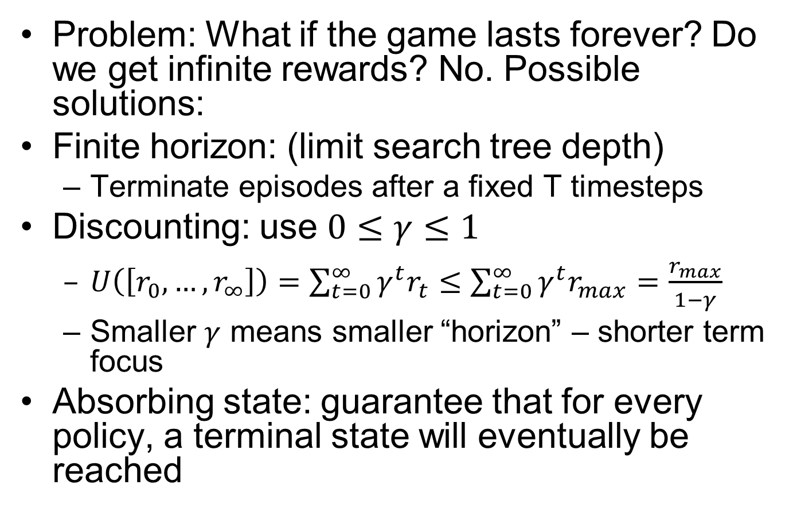
Preventing Infinite Rewards
Problem: What if the game lasts forever? Do we get infinite rewards? No. Possible solutions:
Finite horizon: (limit search tree depth)
Terminate episodes after a fixed T timesteps
Discounting: use $0≤γ≤1$
$U\left(\left[r_{0},…,r_{∞}\right]\right)=\sum_{t=0}^{∞}{γ^{t}r_{t}}≤\sum_{t=0}^{∞}{γ^{t}r_{max}}=\frac{r_{max}}{1−γ}$
Smaller $γ$ means smaller “horizon” – shorter term focus
Absorbing state: guarantee that for every policy, a terminal state will eventually be reached

Slide 13





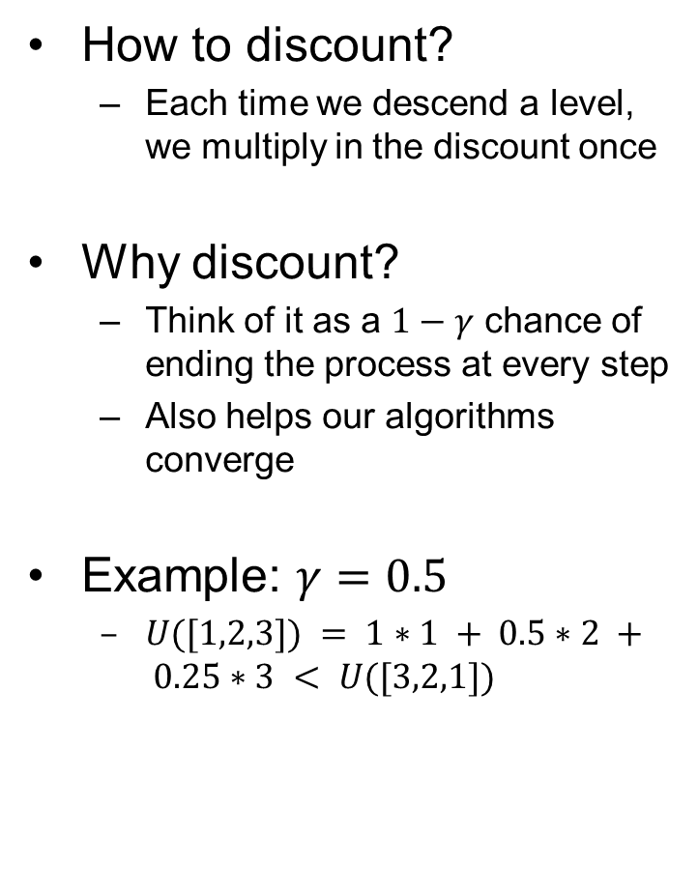
Discounting
How to discount?
Each time we descend a level, we multiply in the discount once
Why discount?
Think of it as a $1−γ$ chance of ending the process at every step
Also helps our algorithms converge
Example: $γ=0.5$
$U([1,2,3]) = 1∗1 + 0.5∗2 + 0.25∗3 < U([3,2,1])$
Notes:
Rewards in the future (deeper in the tree) matter less
Interesting: running expectimax, if having to truncate the search, then not losing much; e.g., less then \gamma^d / (1-\gamma)
Augment q states with another option: instant death!
Repeated loop, difference from search, is a win. Distinction of visiting a state.
Do the example.

Slide 14

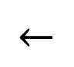
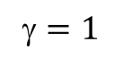
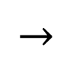
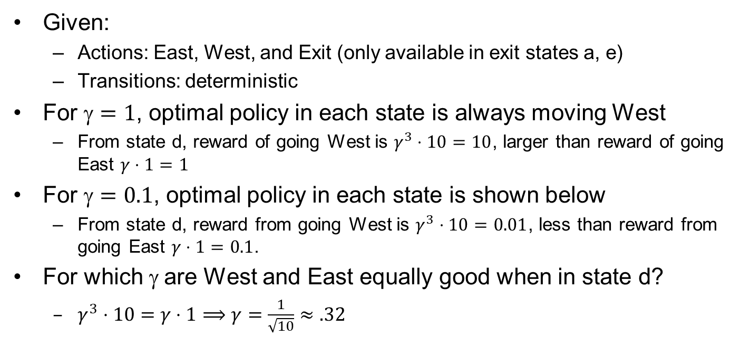
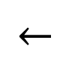
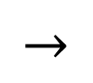
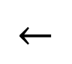
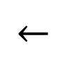
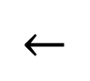
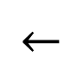
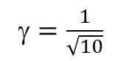
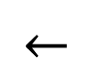
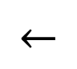
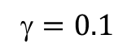
Discounting Example
Given:
Actions: East, West, and Exit (only available in exit states a, e)
Transitions: deterministic
For $=1$, optimal policy in each state is always moving West
From state d, reward of going West is $γ^{3}⋅10=10$, larger than reward of going East $γ⋅1=1$
For $=0.1$, optimal policy in each state is shown below
From state d, reward from going West is $γ^{3}⋅10=0.01$, less than reward from going East $γ⋅1=0.1$.
For which $$ are West and East equally good when in state d?
$γ^{3}⋅10=γ⋅1⟹γ=\frac{1}{\sqrt{10}}≈.32$
$$←$$
$$←$$
$$←$$
$$←$$
$$←$$
$$→$$
$$←$$
$$←$$
$$←$$
$$→$$
$=1$
$=0.1$
$=\frac{1}{\sqrt{10}}$

Slide 15
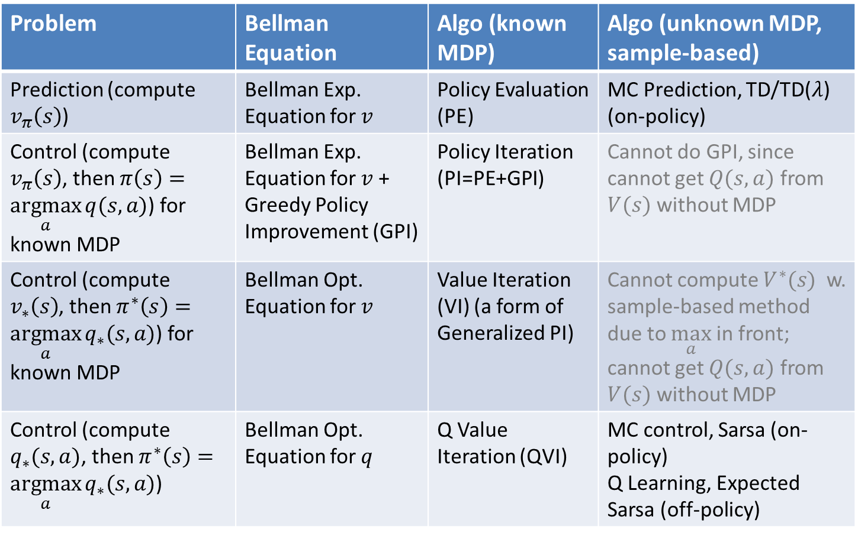
The Big Picture
Important
Problem | Bellman Equation | Algo (known MDP) | Algo (unknown MDP, sample-based)
Prediction (compute $v_{π}\left(s\right)$) | Bellman Exp. Equation for $v$ | Policy Evaluation (PE) | MC Prediction, TD/TD($λ$) (on-policy)
Control (compute $v_{π}\left(s\right)$, then $π\left(s\right)=\underset{a}{argmax}{q(s,a)}$) for known MDP | Bellman Exp. Equation for $v$ + Greedy Policy Improvement (GPI) | Policy Iteration (PI=PE+GPI) | Cannot do GPI, since cannot get $Q(s,a)$ from $V(s)$ without MDP
Control (compute $v_{∗}\left(s\right)$, then $π^{∗}\left(s\right)=\underset{a}{argmax}{q_{∗}(s,a)}$) for known MDP | Bellman Opt. Equation for $v$ | Value Iteration (VI) (a form of Generalized PI) | Cannot compute $V^{∗}(s)$ w. sample-based method due to $\max_{a}$ in front; cannot get $Q(s,a)$ from $V(s)$ without MDP
Control (compute $q_{∗}(s,a)$, then $π^{∗}\left(s\right)=\underset{a}{argmax}{q_{∗}(s,a)}$) | Bellman Opt. Equation for $q$ | Q Value Iteration (QVI) | MC control, Sarsa (on-policy) Q Learning, Expected Sarsa (off-policy)
Notes:
MC Control

Slide 16
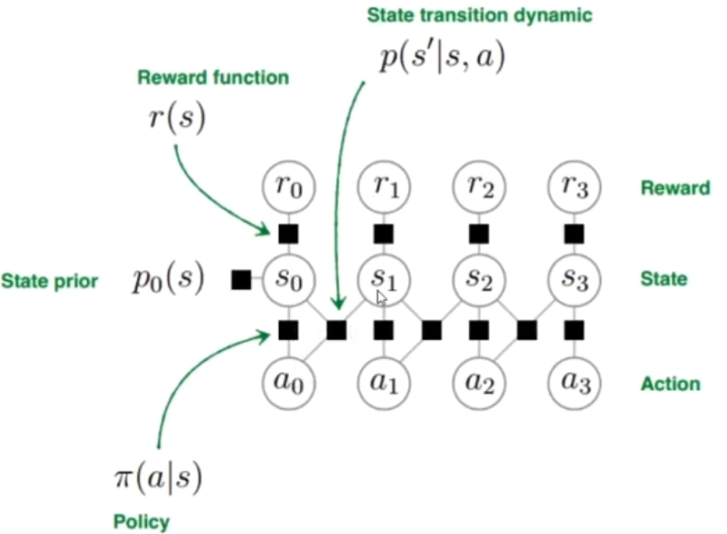
Known MDP
In this lecture, we assume known MDP, and use dynamic programming to solve Bellman Equations and find the optimal policy (no learning here).
known
known
want to optimize
Notes:
https://www.bilibili.com/video/BV1hg4y1873j?from=search&seid=14821159815301028409

Slide 17
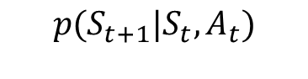



Definition of Terms
Important
Return (cumulative discounted reward) at time $t$: $G_{t}≐R_{t+1}+γR_{t+2}+γ^{2}R_{t+3}+…+γ^{T−1}R_{T}=\sum_{k=0}^{T−t−1}{γ^{k}}R_{t+k+1}$
At each step $t∈[0,T−1]$, agent takes an action $A_{t}$ in state $S_{t}$; at step $t+1$, agent receives a reward $R_{t+1}$ and transitions into the next state $S_{t+1}$ with the trace $(S_{t}, A_{t}, R_{t+1}, S_{t+1})$
We assume episodic tasks, and this specific episode has length of $T$ steps. ($T=∞$ for continuous tasks)
State Value Function: expected return under policy $π$: $v_{π}\left(s\right)≐𝔼_{π}\left[G_{t} | S_{t}=s\right]$
Action Value Function: expected return from taking action $a$, then follow policy $π$: $q_{π}\left(s,a\right)≐𝔼_{π}\left[G_{t} | S_{t}=s,A_{t}=a\right]$
The RL problem: find the optimal policy that maximizes the expected return from each state
$${p(S}_{t+1}|S_{t},A_{t})$$
Environment
Action $A_{t}$
Reward $R_{t+1}$
State $S_{t+1}$
RL Agent

Slide 18

Bellman Expectation Equations
Important
Bellman Expectation Equation for State Value Function:
$v_{π}\left(s\right)=\sum_{a}{π\left(a | s\right)}\sum_{r,s^{′}}{p\left(r,s′ | s,a\right)}\left[r+γv_{π}\left(s^{′}\right)\right]$
Expected value starting from state $s$ and following policy $π$.
Bellman Expectation Equation for Action Value Function
$q_{π}\left(s,a\right)=\sum_{r,s^{′}}{p\left(r,s′ | s,a\right)}\left[r+γ\sum_{a′}{π\left(a′ | s′\right)}q_{π}\left(s′,a′\right)\right]$
Expected value starting from state $s$, taking action $a$, and thereafter following policy $π$.
Relating $v_{π}\left(s\right)$ and $q_{π}\left(s,a\right)$:
$v_{π}\left(s\right)=\sum_{a}{π\left(a | s\right)}q_{π}\left(s,a\right)$
$q_{π}\left(s,a\right)=\sum_{r,s^{′}}{p\left(r,s′ | s,a\right)}\left[r+γv_{π}\left(s′\right)\right]$
Notes:
$=𝔼_{π}[R_{t+1}+γv_{π}(S_{t+1})|S_{t}=s]$ $=𝔼_{π}[R_{t+1}+γv_{π}(S_{t+1})|S_{t}=s, A_{t}=a]$

Slide 19



Bellman Optimality Equations
Important
Bellman Optimality Equation for State Value Function:
$v_{∗}\left(s\right)=$ $\max_{a}{\sum_{r,s^{′}}{p\left(r,s′ | s,a\right)}\left[r+γv_{∗}\left(s^{′}\right)\right]}=\max_{a}{𝔼_{π}[R_{t+1}+γv_{∗}(S_{t+1})|S_{t}=s,A_{t}=a]}$
Max value starting from state $s$ and following the greedy policy $π\left(s\right)=$ $\underset{a}{argmax}{q_{∗}\left(s,a\right)}$
Bellman Optimality Equation for Action Value Function
$q_{∗}\left(s,a\right)=\sum_{r,s^{′}}{p\left(r,s′ | s,a\right)}\left[r+γ\max_{a′} q_{∗}\left(s′,a′\right)\right]=𝔼_{π}[R_{t+1}+γv_{∗}(S_{t+1})|S_{t}=s, A_{t}=a]$
Max value starting from state $s$, taking action $a$, and thereafter following the greedy policy $π\left(s\right)=$ $\underset{a}{argmax}{q_{∗}\left(s,a\right)}$
Relating $v_{∗}\left(s\right)$ and $q_{∗}\left(s,a\right)$:
$v_{∗}\left(s\right)=\max_{a} q_{∗}\left(s,a\right);q_{∗}\left(s,a\right)=\sum_{r,s^{′}}{p\left(r,s′ | s,a\right)}\left[r+γv_{∗}\left(s′\right)\right]$
Notations in left fig:
$\sum_{s^{′}}{T(s,a,s′)}[…]=\sum_{r,s^{′}}{p\left(r,s^{′} | s,a\right)}[…]$
$R\left(s,a\right)=\sum_{r,s^{′}}{p\left(r,s^{′} | s,a\right)}r$
Notes:
$$v_{∗}\left(s\right)=\max_{a} q_{∗}\left(s,a\right);q_{∗}\left(s,a\right)=\sum_{r,s^{′}}{p\left(r,s′ | s,a\right)}\left[r+γv_{∗}\left(s′\right)\right]$$
$$q_{∗}\left(C,l\right)=\sum_{r,s^{′}}{p\left(r,s′ | s,a\right)}\left[r+γv_{∗}\left(s′\right)\right]$$

Slide 20

Simplified Bellman Equations for Deterministic Env
Important
Bellman Equations:
$v_{π}\left(s\right)=\sum_{a}{π\left(a | s\right)q_{π}(s,a)}$
$q_{π}\left(s,a\right)=\sum_{{r, s}^{′}}{p\left(r,s′ | s,a\right)}\left[r+γv_{π}\left(s^{′}\right)\right]$
$v_{∗}\left(s\right)=\max_{a} q_{∗}\left(s,a\right)$
$q_{∗}\left(s,a\right)=\sum_{{r, s}^{′}}{p\left(r,s′ | s,a\right)}\left[r+γv_{∗}\left(s′\right)\right]$
For Deterministic Env: there is only one possible $(r,s^{′})$ for a given $(s,a)$ (we use $R_{s}^{a}$ to emphasize that reward $r$ is specific to this $(s,a)$):
$q_{π}\left(s,a\right)=R_{s}^{a}+γv_{π}\left(s^{′}\right)$
$q_{∗}\left(s,a\right)=R_{s}^{a}+γv_{∗}\left(s^{′}\right)$

Slide 21








Backup Diagrams
Important
$π\left(a | s\right)$: agent takes action $a$
(state, action)
$p\left(r,s′ | s,a\right)$: env gives reward $r$ and moves agent to $s′$
max
state
Bellman Exp Eqn for $v_{π}\left(s\right)$
Bellman Opt Eqn for $v_{∗}\left(s\right)$
$$p\left(r,s′ | s,a\right)$$
$$π\left(a | s\right)$$
max
max
Bellman Exp Eqn for $q_{π}\left(s,a\right)$
Bellman Opt Eqn for $q_{∗}\left(s,a\right)$

Slide 22


$v(s)$ vs. $q(s,a)$
Important
State-action Value Function $q(s,a)$ contains more information than State value function $v(s)$. Given $q_{∗}\left(s,a\right)$, optimal policy $π_{∗}\left(s\right)=arg\max_{a} q_{∗}\left(s,a\right)$.
Can always go from $q_{π}(s,a)$ to $v_{π}(s)$, or from $q_{∗}(s,a)$ to $v_{∗}(s)$:
$v_{π}\left(s\right)=\sum_{a}{π\left(a | s\right)}q_{π}\left(s,a\right);v_{∗}\left(s\right)=\max_{a} q_{∗}\left(s,a\right)$
With known MDP ($p\left(r,s′ | s,a\right)$, i.e., model-based): can go from $v_{π}(s)$ to $q_{π}(s,a)$, or from $v_{∗}(s)$ to $q_{∗}(s,a)$:
$q_{π}\left(s,a\right)=\sum_{r,s^{′}}{p\left(r,s′ | s,a\right)}\left[r+γv_{π}\left(s′\right)\right]$
$q_{∗}\left(s,a\right)=\sum_{{r,s}^{′}}{p\left(r,s′ | s,a\right)}\left[r+γv_{∗}\left(s′\right)\right]$
With unknown MDP (unknown $p\left(r,s′ | s,a\right)$, i.e., model-free) : cannot go from $v_{π}(s)$ to $q_{π}(s,a)$, or from $v_{∗}(s)$ to $q_{∗}(s,a)$
Notes:
Can get optimal policy $π_{∗}\left(s\right)=arg\max_{a} q_{∗}\left(s,a\right)$
Cannot get optimal policy $π_{∗}\left(s\right)$ from $v_{∗}\left(s\right)$

Slide 23

Policy Evaluation
The prediction problem: predict Value Function for given policy $π$ by solving Bellman Exp. Equation for State Value Function
$v_{π}\left(s\right)=\sum_{a}{π\left(a | s\right)}\sum_{{r,s}^{′}}{p\left(r,s′ | s,a\right)}\left[r+γv_{π}\left(s^{′}\right)\right]=𝔼_{π}[R_{t+1}+γv_{π}(S_{t+1})|S_{t}=s]$
Can also be written as:
$v_{π}\left(s\right)=\sum_{a}{π\left(a | s\right)q_{π}(s,a)}$
$q_{π}\left(s,a\right)=\sum_{{r, s}^{′}}{p\left(r,s′ | s,a\right)}\left[r+γv_{π}\left(s^{′}\right)\right]$ denotes the State-Action Value Function for taking action $a$ in state $s$, then follow policy $π$ afterwards
A set of linear equations that can be solved analytically for small system
# unknowns = # equations = # states
Notes:
Turn recursive Bellman equations into updates
(like value iteration)
Computationally efficient:
Without the max operator, the Bellman equations are just
$$V_{0}^{π}\left(s\right)=0$$
$$V_{k+1}^{π}\left(s\right)=\sum_{s′}{T\left(s,π(s),s^{′}\right)}[R(s,π(s),s^{′})+γV_{k}(s′)]$$

Slide 24



Grid World1: Policy Evaluation
Non-episodic MDP w. deterministic env: Agent in state $s∈\left\{A,B,C,D\right\}$ taking action $a∈\left\{l,r,u,d\right\}$ always moves to the next state in the movement direction, unless it is blocked by the walls. Discount factor $γ=0.7$.
Random policy: Agent in state $s∈\left\{A,B,C,D\right\}$ takes a random action $a∈\left\{l,r,u,d\right\}$ with equal probability of $0.25$ each.
Bellman Exp. Equation for det env:$v_{π}\left(s\right)=\sum_{a}{π\left(a | s\right)q_{π}(s,a)}; q_{π}\left(s,a\right)=R_{s}^{a}+γv_{π}\left(s^{′}\right)$
$v_{π}\left(A\right)=0.25\left(q_{π}\left(A,l\right)+q_{π}\left(A,r\right)+q_{π}\left(A,u\right)+q_{π}(A,d)\right)=0.5⋅0.7v_{π}\left(A\right)+0.25⋅\left(5+0.7v_{π}\left(B\right)\right)+0.25⋅0.7v_{π}\left(C\right)$
$q_{π}\left(A,l\right)=q_{π}\left(A,u\right)=0+0.7v_{π}\left(A\right)$
$q_{π}\left(A,r\right)=5+0.7v_{π}\left(B\right)$
$q_{π}\left(A,d\right)=0+0.7v_{π}\left(C\right)$
$v_{π}\left(B\right)=0.25\left(q_{π}\left(B,l\right)+q_{π}\left(B,r\right)+q_{π}\left(B,u\right)+q_{π}(B,d)\right)=0.25⋅0.7v_{π}\left(A\right)+0.5⋅\left(5+0.7v_{π}\left(B\right)\right)+0.25⋅0.7v_{π}\left(D\right)$
$q_{π}\left(B,l\right)=0+0.7v_{π}\left(A\right)$
$q_{π}\left(B,r\right)=q_{π}\left(A,u\right)=5+0.7v_{π}\left(B\right)$
$q_{π}\left(B,d\right)=0+0.7v_{π}\left(D\right)$
$v_{π}\left(C\right)=0.25\left(q_{π}\left(C,l\right)+q_{π}\left(C,r\right)+q_{π}\left(C,u\right)+q_{π}(C,d)\right)=0.25⋅0.7v_{π}\left(A\right)+0.5⋅0.7v_{π}\left(C\right)+0.25⋅0.7v_{π}\left(D\right)$
$q_{π}\left(C,l\right)=q_{π}\left(C,d\right)=0+0.7v_{π}\left(C\right)$
$q_{π}\left(C,r\right)=0+0.7v_{π}\left(D\right)$
$q_{π}\left(C,u\right)=0+0.7v_{π}\left(A\right)$
$v_{π}\left(D\right)=0.25\left(q_{π}\left(D,l\right)+q_{π}\left(D,r\right)+q_{π}\left(D,u\right)+q_{π}(D,d)\right)=0.25⋅(5+0.7v_{π}\left(B\right))+0.25⋅0.7v_{π}\left(C\right)+0.5⋅0.7v_{π}\left(D\right)$
$q_{π}\left(D,l\right)=0+0.7v_{π}\left(C\right)$
$q_{π}\left(D,r\right)=q_{π}\left(D,d\right)=0+0.7v_{π}\left(D\right)$
$q_{π}\left(D,u\right)=5+0.7v_{π}\left(B\right)$
Solution: $v_{π}\left(A\right)=4.2,v_{π}\left(B\right)=6.1,$ $v_{π}\left(C\right)=2.2,v_{π}\left(D\right)=4.2$. $q_{π}\left(s,a\right)$ can also be obtained.
BF=4
BF=1
(BF: Branching Factor)
Notes:
In the back diagrams, BF denotes Branching Factor of backup diagram.

Slide 25


Iterative Policy Evaluation
If # states are too large, it may be too expensive to analytically solve the set of linear Bellman Exp. Equations. We can use Iterative Policy Evaluation and solve the recursive Bellman equations iteratively:
$v\left(s\right)=Bellman\left(v\left(s^{′}\right)\right)⇒v_{k}\left(s\right)←Bellman(v_{k−1}\left(s′\right))$
In-place updates:
For faster convergence, update $v_{k}\left(s\right)$ using the value of $v_{k}\left(s′\right)$ that has been updated in the same iteration, instead of $v_{k−1}\left(s′\right)$ from the previous iteration.
$v_{k}\left(s\right)←Bellman(v_{k}\left(s′\right))$

Slide 26


Iterative Policy Evaluation Example
An episodic MDP with terminal states with $v\left(s\right)=0$ located in the top left and bottom right corners. Reward $R=−1$ for every transition (agent is punished for delays before reaching the terminal state and ending the episode). Discount factor $γ=1$. Four possible actions in each state: up, down, left, and right. Environment is deterministic. If the action would move the agent off the grid, it instead leaves the agent in the same state.
Random policy: Agent in any state $s$ takes a random action $a∈\left\{l,r,u,d\right\}$ with equal probability of $0.25$ each.
Notes:
The terminal state is shown in two places,
but formally it is the same state.
Since the problem is episodic,
let's consider the undiscounted case of gamma equals 1.

Slide 27





Iterative Policy Evaluation Example
For fixed random policy:
Bellman Exp. Equation for Det Env:$v_{π}\left(s\right)=\sum_{a}{π\left(a | s\right)q_{π}(s,a)}; q_{π}\left(s,a\right)=R_{s}^{a}+γv_{π}\left(s^{′}\right)$
1st sweep:
for all states $v_{π}\left(s\right)=.25(\left(−1+0\right)+(−1+0)+\left(−1+0\right)+\left(−1+0\right))=−1$
2nd sweep:
For states marked $−2$: $v_{π}\left(s\right)=.25(\left(−1−1\right)+(−1−1)$ $+ \left(−1−1\right)+\left(−1−1\right))=−2$
For states marked $−1.7$: $v_{π}\left(s\right)=.25(\left(−1+0\right)+(−1−1)+\left(−1−1\right)+\left(−1−1\right))=−1.75$
3rd sweep:
For states marked $−2.4$: $v_{π}\left(s\right)=.25(\left(−1+0\right)+(−1−2)+\left(−1−1.75\right)+\left(−1−2\right))=−2.43$
For states marked $−2.9$: $v_{π}\left(s\right)=.25(\left(−1−1.7\right)+(−1−2)+\left(−1−1.75\right)+\left(−1−2\right))=−2.85$
For states marked $−3$: $v_{π}\left(s\right)=.25(\left(−1−2\right)+(−1−2)+\left(−1−2\right)+\left(−1−2\right))=−3$
Influence of terminal states gradually spreads through the entire grid.
$$0$$ | $$0$$ | $$0$$ | $$0$$
$$0$$ | $$0$$ | $$0$$ | $$0$$
$$0$$ | $$0$$ | $$0$$ | $$0$$
$$0$$ | $$0$$ | $$0$$ | $$0$$
0 | $$−1$$ | $$−1$$ | $$−1$$
$$−1$$ | $$−1$$ | $$−1$$ | $$−1$$
$$−1$$ | $$−1$$ | $$−1$$ | $$−1$$
$$−1$$ | $$−1$$ | $$−1$$ | 0
$$0$$ | $$−1.7$$ | $$−2$$ | $$−2$$
$$−1.7$$ | $$−2$$ | $$−2$$ | $$−2$$
$$−2$$ | $$−2$$ | $$−2$$ | $$−1.7$$
$$−2$$ | $$−2$$ | $$−1.7$$ | 0
$$0$$ | $$−2.4$$ | $$−2.9$$ | $$−3$$
$$−2.4$$ | $$−2.9$$ | $$−3$$ | $$−2.9$$
$$−2.9$$ | $$−3$$ | $$−2.9$$ | $$−2.4$$
$$−3$$ | $$−2.9$$ | $$−2.4$$ | 0
Initial
After 1st sweep
After 2nd sweep
After 3rd sweep
Notes:
Consider each direction in the order (left, right, up, down).

Slide 28



Iterative Policy Evaluation Results
Figure 4.1: Convergence of iterative policy evaluation on a small gridworld with the random policy (all actions equally likely). The left column is the sequence of approximations of the state-value function. The right column is the sequence of greedy policies corresponding to the value function $v_{π}(s)$ estimates.
Note that we are not updating the policy (always the random policy) across iterations. If you follow the greedy action at the current step, then follow the random policy in the future, then it is better than following the random policy from the current step.
Notes:
Sent email to author

Slide 29



Policy Iteration
Important
Repeat until policy converges:
Policy Evaluation: Estimate state value function $v_{π}$ for some fixed policy $π$ with Iterative Policy Evaluation (or solving linear equations).
Policy Improvement: generate new policy based on the newly estimated $v_{π}$: $π=greedy(v_{π})$.

Slide 30


Policy Iteration Illustration

Slide 31



Policy Iteration Example
An episodic MDP with terminal states with $v\left(s\right)=0$ located in the top left corner. Blue states are bad states with large negative reward.
Start with uniform random policy.
Initialize $v\left(s\right)=0$ for all $s$.

Slide 32




After 1st sweep of PE+PI. Most state’s policies are not good since they go towards blue states (darker colors denote low-value states).
Bad policy
Better policy
After 2nd sweep of PE+PI. Policies are much better, but a few states’ policies still go towards blue states.

Slide 33




Higher value
Better policy
Higher value
Better policy

Slide 34




Higher value
Better policy
Value functions converged
(May not converge in general. Policy often
stable long before value functions converge.)
Policy stable, hence it is optimal policy)

Slide 35


Another PI Example
The greedy policy converges to the optimal policy after 5th iteration of Policy Iteration.
Precise values of $v(s)$ are not necessary for computing optimal policy with Policy Iteration.
Notes:
XXX For the same policy, the same set of linear equations, why would VF keep changing? Is it only for GPI where PE is not to convergence?

Slide 36


Value Iteration
Important
Obtain optimal Value Function by solving Bellman Opt. Equation for Optimal State Value Function iteratively (analytical solution is not possible due to the max operator)
$v_{∗}\left(s\right)=$ $\max_{a}{\sum_{r,s^{′}}{p\left(r,s′ | s,a\right)}\left[r+γv_{∗}\left(s^{′}\right)\right]}$
Optimal policy $π_{∗}(s)$ is output at the end; intermediate value function $v(s)$ may not correspond to any valid policy.

Slide 37

Generalized Policy Iteration (GPI)
GPI: 1. evaluate given policy; 2. Improve policy by acting greedily w.r.t its value function. GPI is guaranteed to converge to the optimal deterministic policy $π^{∗}$.
Two special cases of GPI:
Policy Iteration (PI) (shown below):
1. Policy evaluation until convergence; 2. Improve policy
Value Iteration (VI):
1. Policy evaluation with one single iteration; 2. improve policy (implicitly)

Slide 38


Modified Policy Iteration
PI is slower per sweep (cycle), with complexity $O\left(\left|A\right|{\left|S\right|}^{2}+{\left|S\right|}^{3}\right)$, and requires fewer sweeps.
VI is faster per sweep, with complexity $O(\left|A\right|{\left|S\right|}^{2})$, and requires more sweeps.
Modified Policy Iteration: run Policy Evaluation for # steps between 1 for VI, and that needed for convergence of $v_{π}(s)$, may achieve best efficiency.
Notes:
Computing $v_{π}(s)$ or $v_{∗}(s)$: $O(mn^{2})$ per iteration, for $m$ actions and $n$ states.
Computing $q_{π}(s,a)$ or $q_{∗}(s,a)$: Complexity $O(m^{2}n^{2})$ per iteration.

Slide 39




Toy Example
Non-episodic MDP with a single state $s$ and single possible action $a$, with reward $r\left(s,a\right)=1$
Policy Iteration:
Policy Evaluation: initial policy $π\left(s\right)=a$, $v_{π}\left(s\right)=\sum_{a}{π\left(a | s\right)(1+γv_{π}\left(s\right))}=1+γv_{π}\left(s\right)⇒v_{π}\left(s\right)=\frac{1}{1−γ}$
$q_{π}\left(s,a\right)=\sum_{r,s^{′}}{p\left(r,s′ | s,a\right)}\left[r+γv_{π}\left(s′\right)\right]=1+\frac{γ}{1−γ}=\frac{1}{1−γ}$
Policy Improvement: policy $π\left(s\right)=\underset{a}{argmax} q_{π}\left(s,a\right)=\underset{a}{argmax}\frac{1}{1−γ}=a=$ old-action. So policy is now stable.
Value Iteration:
$v_{∗}\left(s\right)=\max_{a} \left(1+γv_{∗}\left(s\right)\right)=1+γv_{∗}\left(s\right)⇒v_{∗}\left(s\right)=\frac{1}{1−γ}$
Value function $v_{∗}\left(s\right)$ is now stable
$q_{∗}\left(s,a\right)=\sum_{r,s^{′}}{p\left(r,s′ | s,a\right)}\left[r+γv_{∗}\left(s′\right)\right]=\frac{1}{1−γ}$
Optimal policy $π_{∗}\left(s\right)=\underset{a}{argmax} q_{∗}\left(s,a\right)=\underset{a}{argmax}\frac{1}{1−γ}=a$.
Both PI and VI converges in one step, since $v_{π}\left(s\right)=v_{∗}\left(s\right)=1+γ+γ^{2}+…=\frac{1}{1−γ}$
$$s$$
$$a$$
$$\left(s,a\right)$$
Notes:
$$γ=0.9$$
$$\max_{a} q_{∗}\left(s,a\right)=$$
$$\sum_{a}{π\left(a | s\right)q_{π}(s,a)}=$$
$$v_{∗}\left(s\right)=\max_{a} q_{∗}\left(s,a\right);q_{∗}\left(s,a\right)=\sum_{r,s^{′}}{p\left(r,s′ | s,a\right)}\left[r+γv_{∗}\left(s′\right)\right]$$
For Deterministic Env: there is only one possible $(r,s^{′})$ for a given $(s,a)$ (we use $R_{s}^{a}$ to emphasize that reward $r$ is specific to this $(s,a)$):
$$q_{π}\left(s,a\right)=R_{s}^{a}+γv_{π}\left(s^{′}\right)$$
$$q_{∗}\left(s,a\right)=R_{s}^{a}+γv_{∗}\left(s^{′}\right)$$

Slide 40
MiniGW Example
Policy Iteration for Deterministic Environment
Policy Iteration for Stochastic Environment
Value Iteration for Deterministic Environment
Value Iteration for Stochastic Environment
Model learning

Slide 41



MiniGW Setup
 | A
B | C | D
 | E
$$−10$$
$$+10$$
All transitions $(s,a,r,s′)$ for $s∈\left\{B,C,E\right\},a∈\left\{l,r,u,d\right\}$ have the same reward $r=−1$.
$A$ and $D$ are terminal states with fixed value function $v\left(A\right)=−10,$ $v\left(D\right)=10$
Or equivalently, you can think of an extra terminal state $x$ with $v\left(x\right)=0$, the only action in state $A$ or $D$ is $exit$ that leads to $x$ with $R_{A}^{a}=−10,R_{D}^{a}=10$.
Dark squares denote obstacles which the agent cannot move into.
Discount factor γ = 1.
Deterministic env: Agent in state $s∈\left\{B,C,E\right\}$ taking action $a∈\left\{l,r,u,d\right\}$ always moves to the next state in the movement direction, unless it is blocked by an obstacle.
Stochastic env: Agent in state $s∈\left\{B,C,E\right\}$ taking action $a∈\left\{l,r,u,d\right\}$ moves to the next state in the movement direction w. prob $0.8$, or to the left or right side, each w. prob $0.1$. If it is blocked by an obstacle in any direction, then it stays in the same state with prob of moving in the blocked direction.
Notes:
We can compute value function based on its definition (suppose all other transitions have reward 0): Suppose we observe transitions (B, east, C, -2) and (C, east, D, -2). We can compute value function based on its definition (suppose all other transitions have reward 0):
For deterministic policy,
$Q\left(s,a\right)=V\left(s\right), a^{∗}=\operatorname{argmax}{Q(s,a)}=$ TODO
MDP is known ($R_{s}^{a},P_{ss^{′}}^{a}$).
If MDP is unknown, we need to use TD-Learning.
$$v_{k+1}\left(s\right)=\max_{a∈A}{(R_{s}^{a}+γ\sum_{s^{′}∈S}{P_{ss^{′}}^{a}v_{k}\left(s^{′}\right)}})$$

Slide 42


Iter1 Policy Evaluation of Random Policy
 | A
B | C | D
 | E
 | A
B | C | D
 | E
$$−10$$
Policy
Eval
$$−10$$
BF=4
BF=1
$$+10$$
-10
-6
$$+10$$
-10
Bellman Exp Equation for Det Env:$v_{π}\left(s\right)=\sum_{a}{π\left(a | s\right)q_{π}\left(s,a\right);}q_{π}\left(s,a\right)=R_{s}^{a}+γv_{π}\left(s^{′}\right)$
Random policy: $π\left(l | s\right)=π\left(r | s\right)=π\left(u | s\right)=π\left(d | s\right)=0.25$
$v_{π}\left(C\right)=.25\left(q_{π}\left(C,l\right)+q_{π}\left(C,r\right)+q_{π}\left(C,u\right)+q_{π}\left(C,d\right)\right)=.25(−4+v_{π}\left(B\right)+v_{π}\left(E\right))$
$q_{π}\left(C,l\right)=−1+v_{π}\left(B\right)$
$q_{π}\left(C,r\right)=−1+v\left(D\right)=−1+10=9$
$q_{π}\left(C,u\right)=−1+v\left(A\right)=−1−10=−11$
$q_{π}\left(C,d\right)= −1+v_{π}\left(E\right)$
$v_{π}\left(B\right)=.25\left(q_{π}\left(B,l\right)+q_{π}\left(B,r\right)+q_{π}\left(B,u\right)+q_{π}\left(B,d\right)\right)=.25(−4+3v_{π}\left(B\right)+v_{π}\left(C\right))$
$q_{π}\left(B,l\right)=q_{π}\left(B,u\right)=q_{π}\left(B,d\right)=−1+v_{π}\left(B\right)$
$q_{π}\left(B,r\right)=−1+v_{π}\left(C\right)$
$v_{π}\left(E\right)=.25\left(q_{π}\left(E,l\right)+q_{π}\left(E,r\right)+q_{π}\left(E,u\right)+q_{π}\left(E,d\right)\right)=.25(−4+3v_{π}\left(E\right)+v_{π}\left(C\right))$
$q_{π}\left(E,l\right)=q_{π}\left(E,r\right)=q_{π}\left(E,d\right)=−1+v_{π}\left(E\right)$
$q_{π}\left(E,u\right)=−1+v_{π}\left(C\right)$
Analytic solution: $v_{π}\left(C\right)=−6,v_{π}\left(B\right)=−10,v_{π}\left(E\right)=−10$
 | $$V_{π}\left(B\right)$$ | $$V_{π}\left(C\right)$$ | $$V_{π}\left(E\right)$$
Iter1 | $$−6$$ | $$−10$$ | $$−10$$
Iter2
Notes:
$$v_{∗}\left(s\right)=\max_{a} q_{∗}\left(s,a\right)$$
$$q_{∗}\left(s,a\right)=\sum_{{r, s}^{′}}{p\left(r,s′ | s,a\right)}\left[r+γv_{∗}\left(s′\right)\right]$$
For Deterministic env $q_{π}\left(s,a\right)=R_{s}^{a}+γv_{π}\left(s^{′}\right)$
$$q_{∗}\left(s,a\right)=R_{s}^{a}+γv_{∗}\left(s^{′}\right)$$
$$v_{π}\left(C\right)=0.25\left(−1+v_{π}\left(B\right)\right)+0.25\left(−1+v_{π}\left(D\right)\right)+0.25\left(−1+V_{π}\left(A\right)\right)+0.25\left(−1+V_{π}\left(E\right)\right)$$
$$v_{π}\left(B\right)=0.75\left(−1+v_{π}\left(B\right)\right)+0.25\left(−1+v_{π}\left(C\right)\right)$$
$$V_{π}\left(E\right)=0.75\left(−1+v_{π}\left(E\right)\right)+0.25\left(−1+v_{π}\left(C\right)\right)$$
We can compute value function based on its definition (suppose all other transitions have reward 0): Suppose we observe transitions (B, east, C, -2) and (C, east, D, -2). We can compute value function based on its definition (suppose all other transitions have reward 0):
For deterministic policy,
$Q\left(s,a\right)=V\left(s\right), a^{∗}=\operatorname{argmax}{Q(s,a)}=$ TODO
If MDP is unknown, we need to use TD-Learning.
$$v_{k+1}\left(s\right)=\max_{a∈A}{(R_{s}^{a}+γ\sum_{s^{′}∈S}{P_{ss^{′}}^{a}v_{k}\left(s^{′}\right)}})$$

Slide 43




Iter1 Policy Improvement
 | A
B | C | D
 | E
 | A
B | C | D
 | E
$$−10$$
Policy
Improv
$$−10$$
-10
-6
$$+10$$
-10
-6
$$+10$$
-10
-10
Plug in values from PE: $v_{π}\left(C\right)=−6,v_{π}\left(B\right)=−10,v_{π}\left(E\right)=−10$, to get new policy $π^{′}$
$π^{′}\left(C\right)=\underset{a∈\left(l,r,u,d\right)}{argmax}{q_{π}\left(C,a\right)}=r$
$q_{π}\left(C,l\right)=−1+v_{π}\left(B\right)=−1−10=−11$
$q_{π}\left(C,r\right)=9$
$q_{π}\left(C,u\right)=−11$
$q_{π}\left(C,d\right)= −1+v_{π}\left(E\right)=−1−10=−11$
$π^{′}\left(B\right)=\underset{a∈\left(l,r,u,d\right)}{argmax}{q_{π}\left(B,a\right)}=r$
$q_{π}\left(B,l\right)=q_{π}\left(B,u\right)=q_{π}\left(B,d\right)=−1+v_{π}\left(B\right)=−1−10=−11$
$q_{π}\left(B,r\right)=−1+v_{π}\left(C\right)=−1−6=−7$
$π^{′}\left(E\right)=\underset{a∈\left(l,r,u,d\right)}{argmax}{q_{π}\left(E,a\right)}=u$
$q_{π}\left(E,l\right)=q_{π}\left(E,r\right)=q_{π}\left(E,d\right)=−1+v_{π}\left(E\right)=−1−10=−11$
$q_{π}\left(E,u\right)=−1+v_{π}\left(C\right)=−1−6=−7$
Notes:
$$v_{π}\left(C\right)=0.25\left(−1+v_{π}\left(B\right)\right)+0.25\left(−1+v_{π}\left(D\right)\right)+0.25\left(−1+V_{π}\left(A\right)\right)+0.25\left(−1+V_{π}\left(E\right)\right)$$
$$v_{π}\left(B\right)=0.75\left(−1+v_{π}\left(B\right)\right)+0.25\left(−1+v_{π}\left(C\right)\right)$$
$$V_{π}\left(E\right)=0.75\left(−1+v_{π}\left(E\right)\right)+0.25\left(−1+v_{π}\left(C\right)\right)$$
We can compute value function based on its definition (suppose all other transitions have reward 0): Suppose we observe transitions (B, east, C, -2) and (C, east, D, -2). We can compute value function based on its definition (suppose all other transitions have reward 0):
For deterministic policy,
$Q\left(s,a\right)=V\left(s\right), a^{∗}=\operatorname{argmax}{Q(s,a)}=$ TODO
If MDP is unknown, we need to use TD-Learning.
$$v_{k+1}\left(s\right)=\max_{a∈A}{(R_{s}^{a}+γ\sum_{s^{′}∈S}{P_{ss^{′}}^{a}v_{k}\left(s^{′}\right)}})$$

Slide 44



Iter2 Policy Evaluation of Det Policy
 | A
B | C | D
 | E
 | A
B | C | D
 | E
$$−10$$
Policy
Eval
$$−10$$
BF=1
BF=1
-10
-6
$$+10$$
8
9
$$+10$$
-10
8
Bellman Exp Equation for Det Env:$v_{π}\left(s\right)=\sum_{a}{π\left(a | s\right)q_{π}\left(s,a\right);}q_{π}\left(s,a\right)=R_{s}^{a}+γv_{π}\left(s^{′}\right)$
Det policy: $π\left(r | B\right)=1;π\left(r | C\right)=1;π\left(u | E\right)=1$
$v_{π}\left(C\right)=1.0q_{π}\left(C,r\right)$
$q_{π}\left(C,r\right)=9$
$v_{π}\left(B\right)=1.0q_{π}\left(B,r\right)$
$q_{π}\left(B,r\right)=−1+v_{π}\left(C\right)$
$v_{π}\left(E\right)=1.0q_{π}\left(E,u\right)$
$q_{π}\left(E,u\right)=−1+v_{π}\left(C\right)$
Analytic solution: $v_{π}\left(C\right)=9;v_{π}\left(B\right)=8;v_{π}\left(E\right)=8$
 | $$V_{π}\left(B\right)$$ | $$V_{π}\left(C\right)$$ | $$V_{π}\left(E\right)$$
Iter1 | $$−6$$ | $$−10$$ | $$−10$$
Iter2 | $$8$$ | $$9$$ | $$8$$
Notes:
We can compute value function based on its definition (suppose all other transitions have reward 0): Suppose we observe transitions (B, east, C, -2) and (C, east, D, -2). We can compute value function based on its definition (suppose all other transitions have reward 0):

Slide 45

Iter2 Policy Improvement
 | A
B | C | D
 | E
 | A
B | C | D
 | E
$$−10$$
Policy
Improv
$$−10$$
8
9
$$+10$$
8
9
$$+10$$
8
8
Plug in values from PE: $v_{π}\left(C\right)=9,v_{π}\left(B\right)=8,v_{π}\left(E\right)=8$, to get new policy $π^{′}$
$π^{′}\left(C\right)=\underset{a∈\left(l,r,u,d\right)}{argmax}{q_{π}\left(C,a\right)}=r$
$q_{π}\left(C,l\right)=−1+v_{π}\left(B\right)=−1+8=7$
$q_{π}\left(C,r\right)=9$
$q_{π}\left(C,u\right)=−11$
$q_{π}\left(C,d\right)= −1+v_{π}\left(E\right)=−1+8=7$
$π^{′}\left(B\right)=\underset{a∈\left(l,r,u,d\right)}{argmax}{q_{π}\left(B,a\right)}=r$
$q_{π}\left(B,l\right)=q_{π}\left(B,u\right)=q_{π}\left(B,d\right)=−1+v_{π}\left(B\right)=7$
$q_{π}\left(B,r\right)=−1+v_{π}\left(C\right)=−1+9=8$
$π^{′}\left(E\right)=\underset{a∈\left(l,r,u,d\right)}{argmax}{q_{π}\left(E,a\right)}=u$
$q_{π}\left(E,l\right)=q_{π}\left(E,r\right)=q_{π}\left(E,d\right)=−1+v_{π}\left(E\right)=7$
$q_{π}\left(E,u\right)=−1+v_{π}\left(C\right)=−1+9=8$
Policy is now stable ($π^{′}=π$), so we have found the optimal policy. (We do not need to re-run Policy Evaluation, since we do not care if the value functions converge as long as the policy is stable.)
Notes:
$$v_{π}\left(C\right)=0.25\left(−1+v_{π}\left(B\right)\right)+0.25\left(−1+v_{π}\left(D\right)\right)+0.25\left(−1+V_{π}\left(A\right)\right)+0.25\left(−1+V_{π}\left(E\right)\right)$$
$$v_{π}\left(B\right)=0.75\left(−1+v_{π}\left(B\right)\right)+0.25\left(−1+v_{π}\left(C\right)\right)$$
$$V_{π}\left(E\right)=0.75\left(−1+v_{π}\left(E\right)\right)+0.25\left(−1+v_{π}\left(C\right)\right)$$
We can compute value function based on its definition (suppose all other transitions have reward 0): Suppose we observe transitions (B, east, C, -2) and (C, east, D, -2). We can compute value function based on its definition (suppose all other transitions have reward 0):
For deterministic policy,
$Q\left(s,a\right)=V\left(s\right), a^{∗}=\operatorname{argmax}{Q(s,a)}=$ TODO
If MDP is unknown, we need to use TD-Learning.
$$v_{k+1}\left(s\right)=\max_{a∈A}{(R_{s}^{a}+γ\sum_{s^{′}∈S}{P_{ss^{′}}^{a}v_{k}\left(s^{′}\right)}})$$

Slide 46
MiniGW Example
Policy Iteration for Deterministic Environment
Policy Iteration for Stochastic Environment
Value Iteration for Deterministic Environment
Value Iteration for Stochastic Environment
Model learning

Slide 47

Iter1 Policy Evaluation of Random Policy
 | A
B | C | D
 | E
 | A
B | C | D
 | E
$$−10$$
Policy
Eval
$$−10$$
BF=4
BF=3
$$+10$$
-10
-6
$$+10$$
-10
Bellman Exp Equation: $v_{π}\left(s\right)=\sum_{a}{π\left(a | s\right)q_{π}(s,a)}; q_{π}\left(s,a\right)=\sum_{r,s^{′}}{p\left(r,s′ | s,a\right)}\left[r+γv_{π}\left(s^{′}\right)\right]$
Random policy: $π\left(l | s\right)=π\left(r | s\right)=π\left(u | s\right)=π\left(d | s\right)=0.25$
Set of equations:
$v_{π}\left(C\right)=.25\left(q_{π}\left(C,l\right)+q_{π}\left(C,r\right)+q_{π}\left(C,u\right)+q_{π}\left(C,d\right)\right)=.25(−4+v_{π}\left(B\right)+v_{π}\left(E\right))$
$q_{π}\left(C,l\right)=.8[−1+v_{π}\left(B\right)]+.1[−1+v(A)]+.1[−1+v_{π}\left(E\right)]=−2+.8v_{π}\left(B\right)+.1v_{π}\left(E\right)$
$q_{π}\left(C,r\right)=.8[−1+v\left(D\right)] +.1[−1+v\left(A\right)]+.1[−1+v_{π}\left(E\right)]=6+.1v_{π}\left(E\right)$
$q_{π}\left(C,u\right)=.8[−1+v\left(A\right)]+.1[−1+v_{π}\left(B\right)]+.1[−1+v\left(D\right)]=−8+.1v_{π}\left(B\right)$
$q_{π}\left(C,d\right)=.8[−1+v_{π}\left(E\right)]+.1[−1+v_{π}\left(B\right)]+.1[−1+v\left(D\right)]=.8v_{π}\left(E\right)+.1v_{π}\left(B\right)$
$v_{π}\left(B\right)=.25\left(q_{π}\left(B,l\right)+q_{π}\left(B,r\right)+q_{π}\left(B,u\right)+q_{π}\left(B,d\right)\right)=.25(−4+3v_{π}\left(B\right)+v_{π}\left(C\right))$
$q_{π}\left(B,l\right)=1.0\left[−1+v_{π}\left(B\right)\right]=−1+v_{π}\left(B\right)$
$q_{π}\left(B,r\right)=.8\left[−1+v_{π}\left(C\right)\right]+.2\left[−1+v_{π}\left(B\right)\right]=−1+.8v_{π}\left(C\right)+.2v_{π}\left(B\right)$
$q_{π}\left(B,u\right)=q_{π}\left(B,d\right)=.9\left[−1+v_{π}\left(B\right)\right]+.1\left[−1+v_{π}\left(C\right)\right]=−1+.9v_{π}\left(B\right)+.1v_{π}\left(C\right)$
$v_{π}\left(E\right)=0.25(q_{π}\left(E,l\right)+q_{π}\left(E,r\right)+q_{π}\left(E,u\right)+q_{π}\left(E,d\right))=.25(−4+3v_{π}\left(E\right)+v_{π}\left(C\right))$
$q_{π}\left(E,l\right)=q_{π}\left(B,r\right)=.9\left[−1+v_{π}\left(E\right)\right]+.1\left[−1+V_{π}\left(C\right)\right]=−1+.9v_{π}\left(E\right)+.1V_{π}\left(C\right)$
$q_{π}\left(E,u\right)=.8\left[−1+v_{π}\left(C\right)\right]+.2\left[−1+v_{π}\left(E\right)\right]=−1+.8v_{π}\left(C\right)+.2v_{π}\left(E\right)$
$q_{π}\left(E,d\right)=1.0\left[−1+v_{π}\left(E\right)\right]=−1+v_{π}\left(E\right)$
Analytic solution: $v_{π}\left(C\right)=−6, v_{π}\left(B\right)=\text{−10},$ $v_{π}\left(E\right)=−10$
 | $$V_{π}\left(B\right)$$ | $$V_{π}\left(C\right)$$ | $$V_{π}\left(E\right)$$
Iter1 | $$−6$$ | $$−10$$ | $$−10$$
Iter2
Notes:
$$0.25\left(−1+0.8v_{π}\left(B\right)+0.1v_{π}\left(A\right)+0.1v_{π}\left(E\right)\right)+0.25\left(−1+0.8v_{π}\left(D\right)+0.1v_{π}\left(A\right)+0.1v_{π}\left(E\right)\right)+0.25\left(−1+0.8v_{π}\left(A\right)+0.1v_{π}\left(B\right)+0.1v_{π}\left(D\right)\right)+0.25\left(−1+0.8v_{π}\left(E\right)+0.1v_{π}\left(B\right)+0.1v_{π}\left(D\right)\right)$$
$$V_{π}\left(B\right)=0.25\left(\right)+0.25\left(−1+0.8v_{π}\left(C\right)+0.2v_{π}\left(B\right)\right)+0.5\left(−1+0.9v_{π}\left(B\right)+0.1v_{π}\left(C\right)\right)$$
$$v_{π}\left(E\right)=0.5\left(−1+0.9v_{π}\left(E\right)+0.1V_{π}\left(C\right)\right)+0.25\left(−1+0.8v_{π}\left(C\right)+0.2v_{π}\left(E\right)\right)+0.25\left(−1+1.0v_{π}\left(E\right)\right)$$
(enumerating actions in the order $(l,r,u,d)$):
We can compute value function based on its definition (suppose all other transitions have reward 0): Suppose we observe transitions (B, east, C, -2) and (C, east, D, -2). We can compute value function based on its definition (suppose all other transitions have reward 0):
For deterministic policy,
$Q\left(s,a\right)=V\left(s\right), a^{∗}=\operatorname{argmax}{Q(s,a)}=$ TODO
If MDP is unknown, we need to use TD-Learning.
$$v_{k+1}\left(s\right)=\max_{a∈A}{(R_{s}^{a}+γ\sum_{s^{′}∈S}{P_{ss^{′}}^{a}v_{k}\left(s^{′}\right)}})$$

Slide 48

Iter1 Policy Improvement
 | A
B | C | D
 | E
 | A
B | C | D
 | E
$$−10$$
Policy
Improv
$$−10$$
-10
-6
$$+10$$
-10
-6
$$+10$$
-10
-10
Plug in values from PE: $v_{π}\left(C\right)=−6,v_{π}\left(B\right)=−10,v_{π}\left(E\right)=−10$, to get new policy $π^{′}$
$π^{′}\left(C\right)=\underset{a∈\left(l,r,u,d\right)}{argmax}{q_{π}\left(C,a\right)}=r$
$q_{π}\left(C,l\right)=−2+.8v_{π}\left(B\right)+.1v_{π}\left(E\right)=−2+.8⋅(−10)+.1⋅(−10)=−11$
$q_{π}\left(C,r\right)=6+.1v_{π}\left(E\right)=6+.1⋅(−10)=5$
$q_{π}\left(C,u\right)=−8+.1v_{π}\left(B\right)=−8+.1⋅(−10)=−9$
$q_{π}\left(C,d\right)=.8v_{π}\left(E\right)+.1v_{π}\left(B\right)=.8⋅(−10)+0.1⋅(−10)=−9$
$π^{′}\left(B\right)=\underset{a∈\left(l,r,u,d\right)}{argmax}{q_{π}\left(B,a\right)}=r$
$q_{π}\left(B,l\right)=−1+v_{π}\left(B\right)=−1+(−10)=−11$
$q_{π}\left(B,r\right)=−1+.8v_{π}\left(C\right)+.2v_{π}\left(B\right)=−1+.8⋅(−6)+.2⋅(−10)=−7.8$
$q_{π}\left(B,u\right)=q_{π}\left(B,d\right)=−1+.9v_{π}\left(B\right)+.1v_{π}\left(C\right)=−1+.9⋅(−10)+.1⋅(−6)=−10.6$
$π^{′}\left(E\right)=\underset{a∈\left(l,r,u,d\right)}{argmax}{q_{π}\left(E,a\right)}=u$
$q_{π}\left(E,l\right)=q_{π}\left(B,r\right)=−1+.9v_{π}\left(E\right)+.1V_{π}\left(C\right)=−1+.9⋅(−10)+.1⋅(−6)=−10.6$
$q_{π}\left(E,u\right)=−1+.8v_{π}\left(C\right)+.2v_{π}\left(E\right)=−1+.8⋅(−6)+.2⋅(−10)=−7.8$
$q_{π}\left(E,d\right)=−1+1.0v_{π}\left(E\right)=−1+1.0⋅(−10)=−11$
Notes:
$$v_{π}\left(C\right)=0.25\left(−1+v_{π}\left(B\right)\right)+0.25\left(−1+v_{π}\left(D\right)\right)+0.25\left(−1+V_{π}\left(A\right)\right)+0.25\left(−1+V_{π}\left(E\right)\right)$$
$$v_{π}\left(B\right)=0.75\left(−1+v_{π}\left(B\right)\right)+0.25\left(−1+v_{π}\left(C\right)\right)$$
$$V_{π}\left(E\right)=0.75\left(−1+v_{π}\left(E\right)\right)+0.25\left(−1+v_{π}\left(C\right)\right)$$
We can compute value function based on its definition (suppose all other transitions have reward 0): Suppose we observe transitions (B, east, C, -2) and (C, east, D, -2). We can compute value function based on its definition (suppose all other transitions have reward 0):
For deterministic policy,
$Q\left(s,a\right)=V\left(s\right), a^{∗}=\operatorname{argmax}{Q(s,a)}=$ TODO
If MDP is unknown, we need to use TD-Learning.
$$v_{k+1}\left(s\right)=\max_{a∈A}{(R_{s}^{a}+γ\sum_{s^{′}∈S}{P_{ss^{′}}^{a}v_{k}\left(s^{′}\right)}})$$

Slide 49



Iter2 Policy Evaluation of Det Policy
 | A
B | C | D
 | E
 | A
B | C | D
 | E
$$−10$$
Policy
Eval
$$−10$$
BF=1
BF=3
-10
-6
$$+10$$
5.3
6.5
$$+10$$
-10
5.3
Bellman Exp Equation: $v_{π}\left(s\right)=\sum_{a}{π\left(a | s\right)q_{π}(s,a)}; q_{π}\left(s,a\right)=\sum_{r,s^{′}}{p\left(r,s′ | s,a\right)}\left[r+γv_{π}\left(s^{′}\right)\right]$
Det policy: $π\left(r | B\right)=1;π\left(r | C\right)=1;π\left(u | C\right)=1$
Set of equations:
$v_{π}\left(C\right)=1.0q_{π}\left(C,r\right)$
$q_{π}\left(C,r\right)=6+0.1v_{π}\left(E\right)$
$v_{π}\left(B\right)=1.0q_{π}\left(B,r\right)$
$q_{π}\left(B,r\right)=−1+.8v_{π}\left(C\right)+.2v_{π}\left(B\right)$
$v_{π}\left(E\right)=1.0q_{π}\left(E,u\right)$
$q_{π}\left(E,u\right)=−1+.8v_{π}\left(C\right)+.2v_{π}\left(E\right)$
Analytic solution: $v_{π}\left(C\right)≈6.5, v_{π}\left(B\right)≈5.3,$ $v_{π}\left(E\right)≈5.3$
 | $$V_{π}\left(B\right)$$ | $$V_{π}\left(C\right)$$ | $$V_{π}\left(E\right)$$
Iter1 | $$−6$$ | $$−10$$ | $$−10$$
Iter2 | $$5.3$$ | $$6.5$$ | $$5.3$$
Notes:
$$q_{π}\left(C,r\right)=−1+0.8v\left(D\right)+0.1v\left(A\right)+0.1v_{π}\left(E\right)=6+0.1v_{π}\left(E\right)$$
$$v_{π}\left(B\right)=−1+0.8v_{π}\left(C\right)+0.2v_{π}\left(B\right)$$
$$v_{π}\left(E\right)=−1+0.8v_{π}\left(C\right)+0.2v_{π}\left(E\right)$$
$$v_{π}\left(C\right)=−1+0.8v_{π}\left(D\right)+0.1v_{π}\left(A\right)+0.1v_{π}\left(E\right)$$
We can compute value function based on its definition (suppose all other transitions have reward 0): Suppose we observe transitions (B, east, C, -2) and (C, east, D, -2). We can compute value function based on its definition (suppose all other transitions have reward 0):
For deterministic policy,
$Q\left(s,a\right)=V\left(s\right), a^{∗}=\operatorname{argmax}{Q(s,a)}=$ TODO
If MDP is unknown, we need to use TD-Learning.
$$v_{k+1}\left(s\right)=\max_{a∈A}{(R_{s}^{a}+γ\sum_{s^{′}∈S}{P_{ss^{′}}^{a}v_{k}\left(s^{′}\right)}})$$

Slide 50

Iter2 Policy Improvement
 | A
B | C | D
 | E
 | A
B | C | D
 | E
$$−10$$
Policy
Improv
$$−10$$
5.3
6.5
$$+10$$
5.3
6.5
$$+10$$
5.3
5.3
Plugging in values from PE: $V_{π}\left(C\right)=6.5, V_{π}\left(B\right)=5.3,$ $V_{π}\left(E\right)=5.3$, we get new policy $π^{′}$
$π^{′}\left(C\right)=\underset{a∈\left(l,r,u,d\right)}{argmax}{q_{π}\left(C,a\right)}=r$
$q_{π}\left(C,l\right)=−2+.8v_{π}\left(B\right)+.1v_{π}\left(E\right)=−2+.8⋅5.3+.1⋅5.3≈2.8$
$q_{π}\left(C,r\right)=6+.1v_{π}\left(E\right)=6+.1⋅5.3≈6.5$
$q_{π}\left(C,u\right)=−8+.1v_{π}\left(B\right)=−8+.1⋅5.3≈−7.5$
$q_{π}\left(C,d\right)=.8v_{π}\left(E\right)+.1v_{π}\left(B\right)=.8⋅5.3+0.1⋅5.3≈4.8$
$π^{′}\left(B\right)=\underset{a∈\left(l,r,u,d\right)}{argmax}{q_{π}\left(B,a\right)}=r$
$q_{π}\left(B,l\right)=−1+v_{π}\left(B\right)=−1+5.3=4.3$
$q_{π}\left(B,r\right)=−1+.8v_{π}\left(C\right)+.2v_{π}\left(B\right)=−1+.8⋅6.5+.2⋅5.3≈5.3$
$q_{π}\left(B,u\right)=q_{π}\left(B,d\right)=−1+.9v_{π}\left(B\right)+.1v_{π}\left(C\right)=−1+.9⋅5.3+.1⋅6.5≈4.4$
$π^{′}\left(E\right)=\underset{a∈\left(l,r,u,d\right)}{argmax}{q_{π}\left(E,a\right)}=u$
$q_{π}\left(E,l\right)=q_{π}\left(B,r\right)=−1+.9v_{π}\left(E\right)+.1V_{π}\left(C\right)=−1+.9⋅5.3+.1⋅6.5≈4.4$
$q_{π}\left(E,u\right)=−1+.8v_{π}\left(C\right)+.2v_{π}\left(E\right)=−1+.8⋅6.5+.2⋅5.3≈5.3$
$q_{π}\left(E,d\right)=−1+v_{π}\left(E\right)=−1+5.3=4.3$
New policy is now stable ($π^{′}=π$), so we have found the optimal policy.
Notes:
$q_{π}\left(B,r\right)=−1+.8v_{π}\left(C\right)+.2v_{π}\left(B\right)=−1+.8\left(6+0.1v_{π}\left(E\right)\right)+.2v_{π}\left(B\right)=3.8+.28∗5.3=$5.284
$$v_{π}\left(C\right)=0.25\left(−1+v_{π}\left(B\right)\right)+0.25\left(−1+v_{π}\left(D\right)\right)+0.25\left(−1+V_{π}\left(A\right)\right)+0.25\left(−1+V_{π}\left(E\right)\right)$$
$$v_{π}\left(B\right)=0.75\left(−1+v_{π}\left(B\right)\right)+0.25\left(−1+v_{π}\left(C\right)\right)$$
$$V_{π}\left(E\right)=0.75\left(−1+v_{π}\left(E\right)\right)+0.25\left(−1+v_{π}\left(C\right)\right)$$
We can compute value function based on its definition (suppose all other transitions have reward 0): Suppose we observe transitions (B, east, C, -2) and (C, east, D, -2). We can compute value function based on its definition (suppose all other transitions have reward 0):
For deterministic policy,
$Q\left(s,a\right)=V\left(s\right), a^{∗}=\operatorname{argmax}{Q(s,a)}=$ TODO
If MDP is unknown, we need to use TD-Learning.
$$v_{k+1}\left(s\right)=\max_{a∈A}{(R_{s}^{a}+γ\sum_{s^{′}∈S}{P_{ss^{′}}^{a}v_{k}\left(s^{′}\right)}})$$

Slide 51
MiniGW Example
Policy Iteration for Deterministic Environment
Policy Iteration for Stochastic Environment
Value Iteration for Deterministic Environment
Value Iteration for Stochastic Environment
Model learning

Slide 52


Bellman Opt Equation for Det Env
 | A
B | C | D
 | E
$$−10$$
BF=4
BF=1
$$+10$$
Bellman Opt Equation for Det Env: $v_{∗}\left(s\right)=\max_{a} q_{∗}\left(s,a\right);q_{∗}\left(s,a\right)=R_{s}^{a}+γv_{∗}\left(s′\right)$
$v_{∗}\left(C\right)=\max_{a} q_{∗}\left(C,a\right)=\max{\{−1+v_{∗}\left(B\right), 9, −11,−1+v_{∗}\left(E\right)\}}$
$q_{∗}\left(C,l\right)=−1+v_{∗}\left(B\right)$
$q_{∗}\left(C,r\right)=−1+v\left(D\right)=9$
$q_{∗}\left(C,u\right)=−1+v\left(A\right)=−11$
$q_{∗}\left(C,d\right)=−1+v_{∗}\left(E\right)$
$v_{∗}\left(B\right)=\max_{a} q_{∗}\left(B,a\right)=\max{\{−1+v_{∗}\left(B\right), −1+v_{∗}\left(C\right),−1+v_{∗}\left(B\right),−1+v_{∗}\left(B\right)\}}$
$q_{∗}\left(B,l\right)=q_{∗}\left(B,u\right)=q_{∗}\left(B,d\right)=−1+v_{∗}\left(B\right)$
$q_{∗}\left(B,r\right)=−1+v_{∗}\left(C\right)$
$v_{∗}\left(E\right)=\max_{a} q_{∗}\left(E,a\right)=\max{\{−1+v_{∗}\left(E\right),−1+v_{∗}\left(E\right), −1+v_{∗}\left(C\right),−1+v_{∗}\left(E\right)\}}$
$q_{∗}\left(E,l\right)=q_{∗}\left(E,r\right)=q_{∗}\left(E,d\right)=−1+v_{∗}\left(E\right)$
$q_{∗}\left(E,u\right)=$ $−1+v_{∗}\left(C\right)$
The set of non-linear equations cannot be solved analytically due to the $max$ operator, so we need to use Value Iteration to find $v_{∗}\left(C\right),v_{∗}\left(B\right),v_{∗}\left(E\right)$
Notes:
(since all transitions $(s,a,r,s′)$ have the same reward $r=−1$, and Det. Env.)
$$=\max{(r+v_{0}\left(B\right),r+v_{0}\left(D\right),r+v_{0}\left(A\right),r+v_{0}\left(E\right)})=max⁡(−1+0,−1+10,−1−10,−1+0)=9$$
We can compute value function based on its definition (suppose all other transitions have reward 0): Suppose we observe transitions (B, east, C, -2) and (C, east, D, -2). We can compute value function based on its definition (suppose all other transitions have reward 0):
If MDP is unknown, we need to use TD-Learning.
$$v_{k+1}\left(s\right)=\max_{a∈A}{(R_{s}^{a}+γ\sum_{s^{′}∈S}{P_{ss^{′}}^{a}v_{k}\left(s^{′}\right)}})$$

Slide 53



Iter1 Value Iteration w. Det Env
 | A
B | C | D
 | E
 | A
B | C | D
 | E
$$−10$$
Value
Iter1
$$−10$$
BF=4
BF=1
0
0
$$+10$$
8
9
$$+10$$
0
8
Value Iteration: $v_{k+1}\left(s\right)=\max_{a} q_{k+1}\left(s,a\right)=\max_{a}\left[r+γv_{k}\left(s^{′}\right)\right]$ w. in-place updates.
Initialize $v_{0}\left(B\right)=$ $v_{0}\left(C\right)=v_{0}\left(E\right)=0$.
$v_{1}\left(C\right)=\max_{a} q_{1}\left(C,a\right)=\max\left(−1, 9,−11, −1\right)=9$
$q_{1}\left(C,l\right)=−1+v_{0}\left(B\right)=−1+0=−1$
$q_{1}\left(C,r\right)=9$
$q_{1}\left(C,u\right)=−11$
$q_{1}\left(C,d\right)=−1+v_{0}\left(E\right)=−1+0=−1$
$v_{1}\left(B\right)=\max_{a} q_{1}\left(B,a\right)=\max{(−1, 8, −1, −1})=8$
$q_{1}\left(B,l\right)=q_{1}\left(B,u\right)=q_{1}\left(B,d\right)=−1+v_{0}\left(B\right)=−1+0=−1$
$q_{1}\left(B,r\right)=$ $r+v_{1}\left(C\right)=−1+9=8$ ($v_{1}\left(C\right)$ computed in the current iteration is used instead of $v_{0}\left(C\right)$)
$v_{1}\left(E\right)=\max_{a} q_{1}\left(E,a\right)=\max{(−1, −1, 8, −1})=8$
$q_{1}\left(E,l\right)=q_{1}\left(E,r\right)=q_{1}\left(E,d\right)=r+v_{0}\left(E\right)=−1+0=−1$
$q_{1}\left(E,u\right)=$ $r+v_{1}\left(C\right)=−1+9=8$ ($v_{1}\left(C\right)$ is used)
After 1st iteration: $v_{1}\left(C\right)=9, v_{1}\left(B\right)=8,$ $v_{1}\left(E\right)=8$
 | $$V_{π}\left(B\right)$$ | $$V_{π}\left(C\right)$$ | $$V_{π}\left(E\right)$$
Iter1 | $$8$$ | $$9$$ | $$8$$
Iter2
Notes:
(since all transitions $(s,a,r,s′)$ have the same reward $r=−1$, and Det. Env.)
$$=\max{(r+v_{0}\left(B\right),r+v_{0}\left(D\right),r+v_{0}\left(A\right),r+v_{0}\left(E\right)})=max⁡(−1+0,−1+10,−1−10,−1+0)=9$$
We can compute value function based on its definition (suppose all other transitions have reward 0): Suppose we observe transitions (B, east, C, -2) and (C, east, D, -2). We can compute value function based on its definition (suppose all other transitions have reward 0):
If MDP is unknown, we need to use TD-Learning.
$$v_{k+1}\left(s\right)=\max_{a∈A}{(R_{s}^{a}+γ\sum_{s^{′}∈S}{P_{ss^{′}}^{a}v_{k}\left(s^{′}\right)}})$$

Slide 54



Iter2 Value Iteration w. Det Env
 | A
B | C | D
 | E
 | A
B | C | D
 | E
Value Function
converged
 | A
B | C | D
 | E
$$−10$$
Value
Iter2
$$−10$$
$$−10$$
8
9
$$+10$$
8
9
$$+10$$
8
9
$$+10$$
Optimal Policy
$arg\max_{a}{Q_{∗}(s,a)}$
8
8
8
Value Iteration: $v_{k+1}\left(s\right)=\max_{a} q_{k+1}\left(s,a\right)=\max_{a}\left[r+γv_{k}\left(s^{′}\right)\right]$ w. in-place updates.
We have now $v_{1}\left(B\right)=v_{1}\left(E\right)=8,v_{1}\left(C\right)=9$.
$v_{2}\left(C\right)=\max_{a} q_{2}\left(C,a\right)=\max\left(7, 9,−11, 7\right)=9$
$q_{2}\left(C,l\right)=−1+v_{1}\left(B\right)=−1+8=7$
$q_{2}\left(C,r\right)=9$
$q_{2}\left(C,u\right)=−11$
$q_{2}\left(C,d\right)=−1+v_{1}\left(E\right)=−1+8=7$
$v_{2}\left(B\right)=\max_{a} q_{2}\left(B,a\right)=\max{(7, 8, 7, 7})=8$
$q_{2}\left(B,l\right)=q_{2}\left(B,u\right)=q_{2}\left(B,d\right)=−1+v_{1}\left(B\right)=−1+8=7$
$q_{2}\left(B,r\right)=$ $−1+v_{2}\left(C\right)=−1+9=8$ ($v_{2}\left(C\right)$ is used, which happens to be equal to $v_{1}\left(C\right)$)
$v_{2}\left(E\right)=\max_{a} q_{2}\left(E,a\right)=\max{(7, 7, 8, 7})=8$
$q_{2}\left(E,l\right)=q_{2}\left(E,r\right)=q_{2}\left(E,d\right)=−1+v_{1}\left(E\right)=−1+8=7$
$q_{2}\left(E,u\right)=$ $−1+v_{2}\left(C\right)=−1+9=8$ ($v_{2}\left(C\right)$ is used)
After 2nd iteration: $v_{2}\left(C\right)=9, v_{2}\left(B\right)=8,$ $v_{2}=8$. VI has converged， so $v_{∗}\left(⋅\right)=v_{2}(⋅)$.
Optimal policy: $π_{∗}\left(C\right)=\underset{a∈\left(l,r,u,d\right)}{argmax}{q_{∗}\left(C,a\right)}=r; π_{∗}\left(B\right)=\underset{a∈\left(l,r,u,d\right)}{argmax}{q_{∗}\left(B,a\right)}=r;π_{∗}\left(E\right)=\underset{a∈\left(l,r,u,d\right)}{argmax}{q_{∗}\left(E,a\right)}=u$
BF=4
BF=1
 | $$V_{π}\left(B\right)$$ | $$V_{π}\left(C\right)$$ | $$V_{π}\left(E\right)$$
Iter1 | $$8$$ | $$9$$ | $$8$$
Iter2 | $$8$$ | $$9$$ | $$8$$
Notes:
(since all transitions $(s,a,r,s′)$ have the same reward $r=−1$, and Det. Env.)
$$=\max{(r+v_{0}\left(B\right),r+v_{0}\left(D\right),r+v_{0}\left(A\right),r+v_{0}\left(E\right)})=max⁡(−1+0,−1+10,−1−10,−1+0)=9$$
We can compute value function based on its definition (suppose all other transitions have reward 0): Suppose we observe transitions (B, east, C, -2) and (C, east, D, -2). We can compute value function based on its definition (suppose all other transitions have reward 0):
If MDP is unknown, we need to use TD-Learning.
$$v_{k+1}\left(s\right)=\max_{a∈A}{(R_{s}^{a}+γ\sum_{s^{′}∈S}{P_{ss^{′}}^{a}v_{k}\left(s^{′}\right)}})$$

Slide 55
MiniGW Example
Policy Iteration for Deterministic Environment
Policy Iteration for Stochastic Environment
Value Iteration for Deterministic Environment
Value Iteration for Stochastic Environment
Model learning

Slide 56



Bellman Opt Equation for Stochastic Env
 | A
B | C | D
 | E
$$−10$$
BF=4
BF=3
$$+10$$
Bellman Opt Equation: $v_{∗}\left(s\right)=\max_{a} q_{∗}\left(s,a\right), q_{∗}\left(s,a\right)=\sum_{{r, s}^{′}}{p\left(r,s′ | s,a\right)}\left[r+γv_{∗}\left(s′\right)\right]$
$v_{∗}\left(C\right)=\max_{a} q_{∗}\left(C,a\right)$
$q_{∗}\left(C,l\right)=.8[−1+v_{∗}\left(B\right)]+.1[−1+v(A)]+.1[−1+v_{∗}\left(E\right)]=−2+.8v_{∗}\left(B\right)+.1v_{∗}\left(E\right)$
$q_{∗}\left(C,r\right)=.8[−1+v\left(D\right)] +.1[−1+v\left(A\right)]+.1[−1+v_{∗}\left(E\right)]=6+.1v_{∗}\left(E\right)$
$q_{∗}\left(C,u\right)=.8[−1+v\left(A\right)]+.1[−1+v_{∗}\left(B\right)]+.1[−1+v\left(D\right)]=−8+.1v_{∗}\left(B\right)$
$q_{∗}\left(C,d\right)=.8[−1+v_{∗}\left(E\right)]+.1[−1+v_{∗}\left(B\right)]+.1[−1+v\left(D\right)]=.8v_{∗}\left(E\right)+.1v_{∗}\left(B\right)$
$v_{1}\left(B\right)=\max_{a} q_{∗}\left(B,a\right)$
$q_{∗}\left(B,l\right)=1.0\left[−1+v_{∗}\left(B\right)\right]=−1+v_{∗}\left(B\right)$
$q_{∗}\left(B,r\right)=.8\left[−1+v_{∗}\left(C\right)\right]+.2\left[−1+v_{∗}\left(B\right)\right]=−1+.8v_{∗}\left(C\right)+.2v_{∗}\left(B\right)$
$q_{∗}\left(B,u\right)=q_{∗}\left(B,d\right)=.9\left[−1+v_{∗}\left(B\right)\right]+.1\left[−1+v_{π}\left(C\right)\right]=−1+.9v_{∗}\left(B\right)+.1v_{∗}\left(C\right)$
$v_{1}\left(E\right)=\max_{a} q_{∗}\left(E,a\right)$
$q_{∗}\left(E,l\right)=q_{∗}\left(B,r\right)=.9\left[−1+v_{∗}\left(E\right)\right]+.1\left[−1+v_{∗}\left(C\right)\right]=−1+.9v_{∗}\left(E\right)+.1v_{∗}\left(C\right)$
$q_{∗}\left(E,u\right)=.8\left[−1+v_{∗}\left(C\right)\right]+.2\left[−1+v_{∗}\left(E\right)\right]=−1+.8v_{∗}\left(C\right)+.2v_{∗}\left(E\right)$
$q_{∗}\left(E,d\right)=1.0\left[−1+v_{∗}\left(E\right)\right]=−1+v_{∗}\left(E\right)$
The set of non-linear equations cannot be solved analytically due to the $max$ operator, so we need to use Value Iteration to find $v_{∗}\left(C\right),v_{∗}\left(B\right),v_{∗}\left(E\right)$
Notes:
$$v_{π}\left(C\right)=.25\left(q_{π}\left(C,l\right)+q_{π}\left(C,r\right)+q_{π}\left(C,u\right)+q_{π}\left(C,d\right)\right)=.25(−4+v_{π}\left(B\right)+v_{π}\left(E\right))$$
$$q_{π}\left(C,l\right)=.8[−1+v_{π}\left(B\right)]+.1[−1+v(A)]+.1[−1+v_{π}\left(E\right)]=−2+.8v_{π}\left(B\right)+.1v_{π}\left(E\right)$$
$$q_{π}\left(C,r\right)=.8[−1+v\left(D\right)] +.1[−1+v\left(A\right)]+.1[−1+v_{π}\left(E\right)]=6+.1v_{π}\left(E\right)$$
$$q_{π}\left(C,u\right)=.8[−1+v\left(A\right)]+.1[−1+v_{π}\left(B\right)]+.1[−1+v\left(D\right)]=−8+.1v_{π}\left(B\right)$$
$$q_{π}\left(C,d\right)=.8[−1+v_{π}\left(E\right)]+.1[−1+v_{π}\left(B\right)]+.1[−1+v\left(D\right)]=.8v_{π}\left(E\right)+.1v_{π}\left(B\right)$$
$$v_{π}\left(B\right)=.25\left(q_{π}\left(B,l\right)+q_{π}\left(B,r\right)+q_{π}\left(B,u\right)+q_{π}\left(B,d\right)\right)=.25(−4+3v_{π}\left(B\right)+v_{π}\left(C\right))$$
$$q_{π}\left(B,l\right)=1.0\left[−1+v_{π}\left(B\right)\right]=−1+v_{π}\left(B\right)$$
$$q_{π}\left(B,r\right)=.8\left[−1+v_{π}\left(C\right)\right]+.2\left[−1+v_{π}\left(B\right)\right]=−1+.8v_{π}\left(C\right)+.2v_{π}\left(B\right)$$
$$q_{π}\left(B,u\right)=q_{π}\left(B,d\right)=.9\left[−1+v_{π}\left(B\right)\right]+.1\left[−1+v_{π}\left(C\right)\right]=−1+.9v_{π}\left(B\right)+.1v_{π}\left(C\right)$$
$$v_{π}\left(E\right)=0.25(q_{π}\left(E,l\right)+q_{π}\left(E,r\right)+q_{π}\left(E,u\right)+q_{π}\left(E,d\right))=.25(−4+3v_{π}\left(E\right)+v_{π}\left(C\right))$$
$$q_{π}\left(E,l\right)=q_{π}\left(B,r\right)=.9\left[−1+v_{π}\left(E\right)\right]+.1\left[−1+V_{π}\left(C\right)\right]=−1+.9v_{π}\left(E\right)+.1V_{π}\left(C\right)$$
$$q_{π}\left(E,u\right)=.8\left[−1+v_{π}\left(C\right)\right]+.2\left[−1+v_{π}\left(E\right)\right]=−1+.8v_{π}\left(C\right)+.2v_{π}\left(E\right)$$
$$q_{π}\left(E,d\right)=1.0\left[−1+v_{π}\left(E\right)\right]=−1+v_{π}\left(E\right)$$
We can compute value function based on its definition (suppose all other transitions have reward 0): Suppose we observe transitions (B, east, C, -2) and (C, east, D, -2). We can compute value function based on its definition (suppose all other transitions have reward 0):
If MDP is unknown, we need to use TD-Learning.
$$v_{k+1}\left(s\right)=\max_{a∈A}{(R_{s}^{a}+γ\sum_{s^{′}∈S}{P_{ss^{′}}^{a}v_{k}\left(s^{′}\right)}})$$

Slide 57




Iter1 Value Iteration w. Sto Env
 | A
B | C | D
 | E
 | A
B | C | D
 | E
$$−10$$
Value
Iter1
$$−10$$
BF=4
BF=3
0
0
$$+10$$
3.8
6
$$+10$$
0
3.8
Value Iteration: $v_{k+1}\left(s\right)=$ $\max_{a} q_{k+1}\left(s,a\right)=\max_{a}\left[r+γ\sum_{s^{′}}{p\left(s′ | s,a\right)}v_{k}\left(s^{′}\right)\right]$ w. in-place updates.
Initialize $v_{0}\left(B\right)=$ $v_{0}\left(C\right)=v_{0}\left(E\right)=0$.
$v_{1}\left(C\right)=\max_{a} q_{1}\left(C,a\right)=\max\left(−2, 6,−8, 0\right)=6$
$q_{1}\left(C,l\right)=−2+.8v_{0}\left(B\right)+.1v_{0}\left(E\right)=−2+.8⋅0+0.1⋅0=−2$
$q_{1}\left(C,r\right)=6+.1v_{0}\left(E\right)=6+0.1⋅0=6$
$q_{1}\left(C,u\right)=−8+.1v_{0}\left(B\right)=−8+0.1⋅0=−8$
$q_{1}\left(C,d\right)=.8v_{0}\left(E\right)+.1v_{0}\left(B\right)=0.8⋅0+0.1⋅0=0$
$v_{1}\left(B\right)=\max_{a} q_{1}\left(B,a\right)=\max\left(−1, 3.8,−0.4, −0.4\right)=3.8$
$q_{1}\left(B,l\right)=−1+v_{0}\left(B\right)=−1+0=−1$
$q_{1}\left(B,r\right)=−1+.8v_{1}\left(C\right)+.2v_{0}\left(B\right)=−1+.8⋅6+.2⋅0=3.8$
$q_{1}\left(B,u\right)=q_{1}\left(B,d\right)=−1+.9v_{0}\left(B\right)+.1v_{1}\left(C\right)=−1+.9⋅0+.1⋅6=−0.4$
$v_{1}\left(E\right)=\max_{a} q_{1}\left(E,a\right)=\max\left(−0.4, −0.4, 3.8, −1\right)=3.8$
$q_{1}\left(E,l\right)=q_{1}\left(E,r\right)=−1+.9v_{0}\left(E\right)+.1v_{1}\left(C\right)=−1+.9⋅0+.1⋅6=−0.4$
$q_{1}\left(E,u\right)=−1+.8v_{1}\left(C\right)+.2v_{0}\left(E\right)=−1+.8⋅6+.2⋅0=3.8$
$q_{1}\left(E,d\right)=−1+v_{0}\left(E\right)=−1+1.0⋅0=−1$
After 1st iteration: $V_{π}\left(C\right)=6, V_{π}\left(B\right)=3.8,$ $V_{π}\left(E\right)=3.8$
 | $$V_{π}\left(B\right)$$ | $$V_{π}\left(C\right)$$ | $$V_{π}\left(E\right)$$
Iter1 | $$3.80$$ | $$6$$ | $$3.80$$
Iter2
Iter3
Iter4
Iter5
Iter6
Notes:
We can compute value function based on its definition (suppose all other transitions have reward 0): Suppose we observe transitions (B, east, C, -2) and (C, east, D, -2). We can compute value function based on its definition (suppose all other transitions have reward 0):
If MDP is unknown, we need to use TD-Learning.
$$v_{k+1}\left(s\right)=\max_{a∈A}{(R_{s}^{a}+γ\sum_{s^{′}∈S}{P_{ss^{′}}^{a}v_{k}\left(s^{′}\right)}})$$

Slide 58


Iter2 Value Iteration w. Sto Env
 | A
B | C | D
 | E
 | A
B | C | D
 | E
$$−10$$
Value
Iter2
$$−10$$
BF=4
BF=3
3.8
6
$$+10$$
4.86
6.38
$$+10$$
3.8
4.86
Value Iteration: $v_{k+1}\left(s\right)=$ $\max_{a} q_{k+1}\left(s,a\right)=\max_{a}\left[r+γ\sum_{s^{′}}{p\left(s′ | s,a\right)}v_{k}\left(s^{′}\right)\right]$ w. in-place updates.
Now: $v_{1}\left(B\right)=v_{1}\left(E\right)=3.8,v_{1}\left(C\right)=6$.
$v_{2}\left(C\right)=\max_{a} q_{2}\left(C,a\right)=\max\left(1.42, 6.38,−7.62, 3.42\right)=6.38$
$q_{2}\left(C,l\right)=−2+.8v_{1}\left(B\right)+.1v_{1}\left(E\right)=−2+.8⋅3.8+.1⋅3.8=1.42$
$q_{2}\left(C,r\right)=6+.1v_{1}\left(E\right)=6+.1⋅3.8=$6.38
$q_{2}\left(C,u\right)=−8+.1v_{1}\left(B\right)=−8+.1⋅3.8=−7.62$
$q_{2}\left(C,d\right)=.8v_{1}\left(E\right)+.1v_{1}\left(B\right)=.8⋅3.8+.1⋅3.8=3.42$
$v_{2}\left(B\right)=\max_{a} q_{2}\left(B,a\right)=\max\left(2.8, 4.86, 3.06, 3.06\right)=4.86$
$q_{2}\left(B,l\right)=−1+v_{1}\left(B\right)=−1+1.0⋅3.8=2.8$
$q_{2}\left(B,r\right)=−1+.8v_{2}\left(C\right)+.2v_{1}\left(B\right)=−1+.8⋅6.38+.2⋅3.8=4.86$
$q_{2}\left(B,u\right)=q_{2}\left(B,d\right)=−1+.9v_{1}\left(B\right)+.1v_{2}\left(C\right)=−1+.9⋅3.8+.1⋅6.38≈3.06$
$v_{2}\left(E\right)=\max_{a} q_{2}\left(E,a\right)=\max\left(3.06, 3.06, 4.86, 2.8\right)=4.86$
$q_{2}\left(E,l\right)=q_{2}\left(E,r\right)=−1+.9v_{1}\left(E\right)+.1v_{2}\left(C\right)=−1+.9⋅3.8+.1⋅6.38≈3.06$
$q_{2}\left(E,u\right)=−1+.8v_{2}\left(C\right)+.2v_{1}\left(E\right)=−1+.8⋅6.38+.2⋅3.8≈4.86$
$q_{1}\left(E,d\right)=−1+v_{1}\left(E\right)=−1+3.8=2.8$
After 2nd iteration: $V_{π}\left(C\right)=6.38, V_{π}\left(B\right)=4.86,$ $V_{π}\left(E\right)=4.86$
 | $$V_{π}\left(B\right)$$ | $$V_{π}\left(C\right)$$ | $$V_{π}\left(E\right)$$
Iter1 | $$3.80$$ | $$6$$ | $$3.80$$
Iter2 | $$4.86$$ | $$6.38$$ | $$4.86$$
Iter3
Iter4
Iter5
Iter6
Notes:
We can compute value function based on its definition (suppose all other transitions have reward 0): Suppose we observe transitions (B, east, C, -2) and (C, east, D, -2). We can compute value function based on its definition (suppose all other transitions have reward 0):
If MDP is unknown, we need to use TD-Learning.
$$v_{k+1}\left(s\right)=\max_{a∈A}{(R_{s}^{a}+γ\sum_{s^{′}∈S}{P_{ss^{′}}^{a}v_{k}\left(s^{′}\right)}})$$

Slide 59



Iter6 Value Iteration w. Sto Env
Value functions $v_{∗}(s)$ converged to $v_{∗}\left(C\right)=6.53,v_{∗}\left(B\right)=v_{∗}\left(E\right)=5.28$ after 6 iterations with threshold condition $Δ≤θ=0.01$. We can get the optimal policy:
$π_{∗}\left(C\right)=\underset{a∈\left(l,r,u,d\right)}{argmax}{q_{∗}\left(C,a\right)}=r$
$π_{∗}\left(B\right)=\underset{a∈\left(l,r,u,d\right)}{argmax}{q_{∗}\left(B,a\right)}=r;$
$π_{∗}\left(E\right)=\underset{a∈\left(l,r,u,d\right)}{argmax}{q_{∗}\left(E,a\right)}=u$
Value Function
converged
 | A
B | C | D
 | E
$$−10$$
5.28
6.53
$$+10$$
Optimal Policy
$arg\max_{a}{Q_{∗}(s,a)}$
5.28
 | $$V_{π}\left(B\right)$$ | $$V_{π}\left(C\right)$$ | $$V_{π}\left(E\right)$$
Iter1 | $$3.80$$ | $$6$$ | $$3.80$$
Iter2 | $$4.86$$ | $$6.38$$ | $$4.86$$
Iter3 | $$5.16$$ | $$6.49$$ | $$5.16$$
Iter4 | $$5.25$$ | $$6.52$$ | $$5.25$$
Iter5 | $$5.27$$ | $$6.52$$ | $$5.27$$
Iter6 | $$5.28$$ | $$6.53$$ | $$5.28$$
Notes:
We can obtain $q_{∗}\left(s,a\right)$ from $v_{∗}\left(s\right)$, but we can also keep track of $q_{∗}\left(s,a\right)$, which are computed during the process of computing $v_{∗}\left(s\right)$.

Slide 60





Policy Iteration w. Deterministic Env
 | A
B | C | D
 | E
 | A
B | C | D
 | E
 | A
B | C | D
 | E
$$−10$$
Policy
Eval
$$−10$$
Policy
Improv
$$−10$$
$$+10$$
-10
-6
$$+10$$
-10
-6
$$+10$$
$$v_{π}(s)$$
$$q_{π}(s,a)$$
$$\underset{a}{argmax}{q_{π}(s,a)}$$
-10
-10
 | A
B | C | D
 | E
 | A
B | C | D
 | E
Policy
Eval
$$−10$$
Policy
Improv
$$−10$$
Policy
converged
8
9
$$+10$$
8
9
$$+10$$
$$v_{π}(s)$$
$$q_{π}(s,a)$$
$$\underset{a}{argmax}{q_{π}(s,a)}$$
8
8

Slide 61
Policy Iteration w. Stochastic Env
 | A
B | C | D
 | E
 | A
B | C | D
 | E
 | A
B | C | D
 | E
$$−10$$
Policy
Eval
$$−10$$
Policy
Improv
$$−10$$
$$+10$$
-10
-6
$$+10$$
-10
-6
$$+10$$
$$v_{π}(s)$$
$$q_{π}(s,a)$$
$$\underset{a}{argmax}{q_{π}(s,a)}$$
-10
-10
 | A
B | C | D
 | E
 | A
B | C | D
 | E
Policy
Eval
$$−10$$
Policy
Improv
$$−10$$
Policy
converged
5.3
6.5
$$+10$$
5.3
6.5
$$+10$$
$$v_{π}(s)$$
$$q_{π}(s,a)$$
$$\underset{a}{argmax}{q_{π}(s,a)}$$
5.3
5.3

Slide 62





Value Iteration w. Deterministic Env
 | A
B | C | D
 | E
 | A
B | C | D
 | E
 | A
B | C | D
 | E
$$−10$$
Value
Iter1
$$−10$$
Value
Iter2
$$−10$$
0
0
$$+10$$
8
9
$$+10$$
8
9
$$+10$$
$$v_{1}(s)$$
$$q_{1}(s,a)$$
$$v_{2}(s)$$
$$q_{2}(s,a)$$
0
8
8
Value Function
converged
 | A
B | C | D
 | E
$$−10$$
8
9
$$+10$$
Optimal Policy
$arg\max_{a}{q_{∗}(s,a)}$
8

Slide 63



Value Iteration w. Stochastic Env
 | A
B | C | D
 | E
 | A
B | C | D
 | E
 | A
B | C | D
 | E
$$−10$$
Value
Iter1
$$−10$$
Value
Iter2
$$−10$$
0
0
$$+10$$
3.8
6
$$+10$$
4.86
6.38
$$+10$$
$$v_{1}(s)$$
$$q_{1}(s,a)$$
$$v_{2}(s)$$
$$q_{2}(s,a)$$
0
3.8
4.86
 | A
B | C | D
 | E
Value Function
converged
 | A
B | C | D
 | E
Value
Iter3
Value
Iter6
$$−10$$
$$−10$$
…
5.28
6.53
$$+10$$
5.28
6.53
$$+10$$
$$v_{3}(s)$$
$$q_{3}(s,a)$$
$$v_{6}(s)$$
$$q_{6}(s,a)$$
Optimal Policy
$arg\max_{a}{q_{∗}(s,a)}$
5.28
5.28

Slide 64
MiniGW Example
Policy Iteration for Deterministic Environment
Policy Iteration for Stochastic Environment
Value Iteration for Deterministic Environment
Value Iteration for Stochastic Environment
Model learning

Slide 65

Model-Based RL
If MDP is not available, we can use Model-Based RL:
Step 1: Learn empirical MDP model
Estimate the model $p\left(r,s′ | s,a\right)$ by executing some policy $π$ (may be random), and keeping track of outcomes $r,s′$ for each $s, a$in the observed episodes.
Step 2: Do planning w. the learned MDP for the optimal policy
Dynamic Programming w. Value Iteration or Policy Iteration
Notes:
Learn an approximate MSP based on experiences, then solve the learned MDP
counting transitions out of each state
CH08: Planning and Learning
Normalize to estimate the probabilities $p\left(r,s′ | s,a\right)$

Slide 66







MiniGW: Model Learning
Input Policy π
Observed Episodes (Training)
Learned Model
Episode 1
Episode 2
$$p\left(s′ | s,a\right)$$
$$p\left(−1,C | B,r\right)=1.0$$
$$p\left(−1,D | C,r\right)=0.75$$
$$p\left(−1,A | C,r\right)=0.25$$
$$p\left(10,x | D,exit\right)=1.0$$
$$p\left(−10,x | A,exit\right)=1.0$$
 | A
B | C | D
 | E
$$(B, r, C, −1)$$
$$(C, r, D, −1)$$
$$(D, exit, x, 10)$$
$$(B, r, C, −1)$$
$$(C, r, D, −1)$$
$$(D, exit, x, +10)$$
Episode 3
Episode 4
$$(E, u, C, −1)$$
$$(C, r, D, −1)$$
$$(D, exit, x, 10)$$
$$(E, u, C, −1)$$
$$(C, r, A, −1)$$
$$(A, exit, x, −10)$$
Assume: γ = 1
In the 4 episodes, we see 4 transitions from $(s=C, a=r)$. 3 of them go to next state $s′=D$, and one goes to next state $s′=A$, each w. reward $−1$. Hence $p\left(−1,D | C,r\right)=0.75;p\left(−1,A | C,r\right)=0.25$.
Notes:
(may update $π$ and re-learn $\hat{T}(s,a,s’)$ iteratively)

